Slide 1
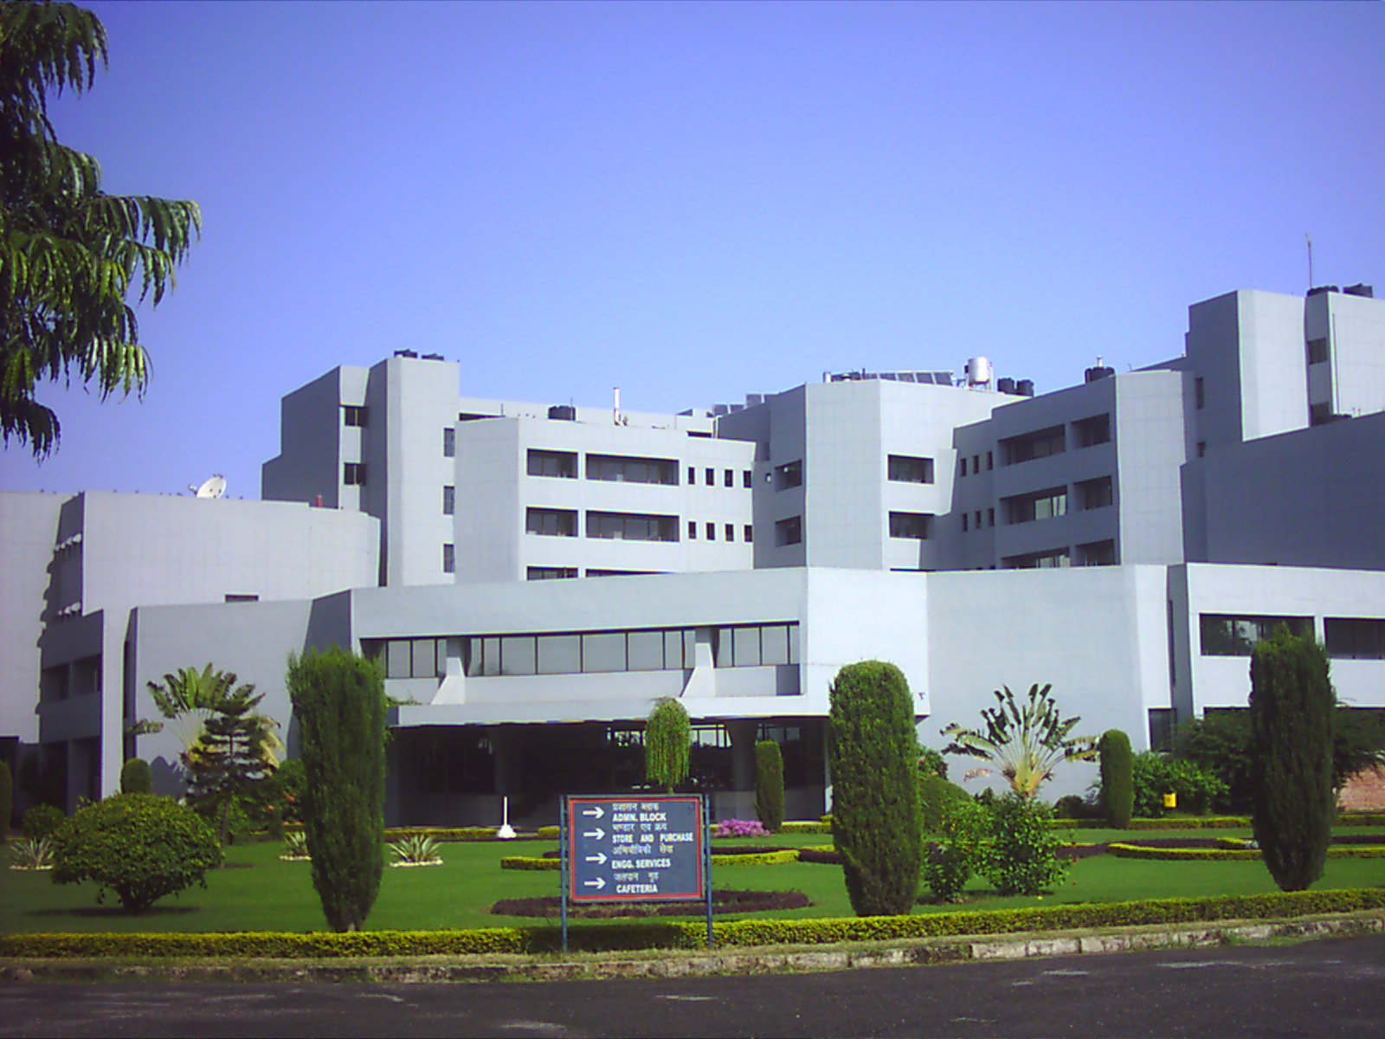
Recent Trends in Computational Proteomics
Dr G P S Raghava
Institute of Microbial Technology, Chandigarh, India
Bioinformatics | Drug Informatics | Chemoinformatics | Vaccine Informatics
Email: raghava@imtech.res.in http://crdd.osdd.net/
http://www.imtech.res.in/raghava/

Slide 2
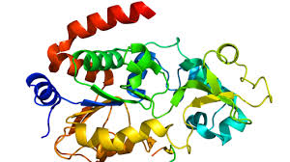

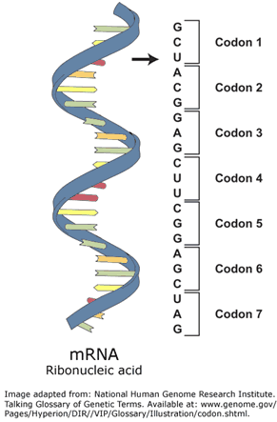
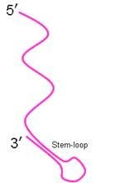
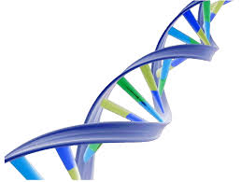
Studying Central Dogma with “Omis”
Transcriptomics
Proteomics
Protein
Mature mRNA
mRNA
Genomics
Metabolomics
(all the endogenous metabolites produced)
DNA

Slide 3
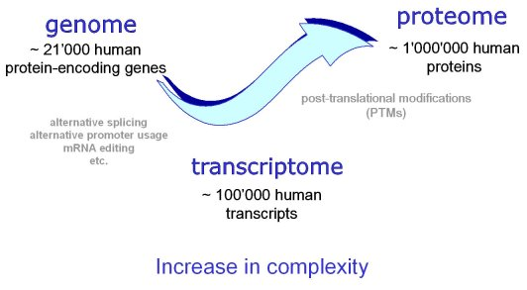
Complexity of the system

Slide 4
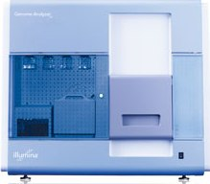
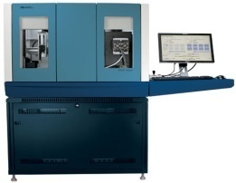
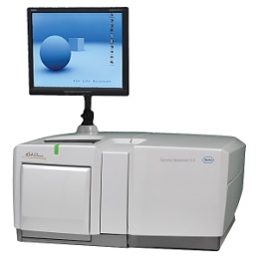
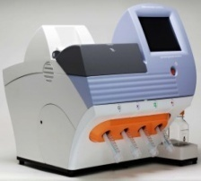
NEXT GENERATION SEQUENCING
Sequence full genome of an organism in a few days at a very low cost.
Produce high throughput data in form of short reads.
Illumina
ABI’s Solid
Roche’s 454 FLX
Ion torrent

Slide 5
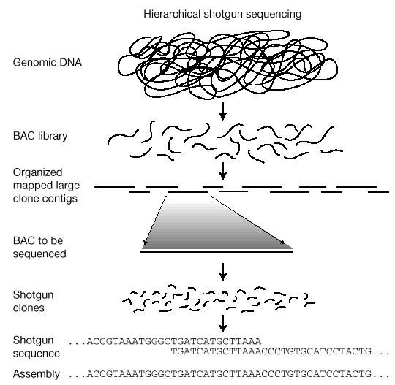

Slide 6
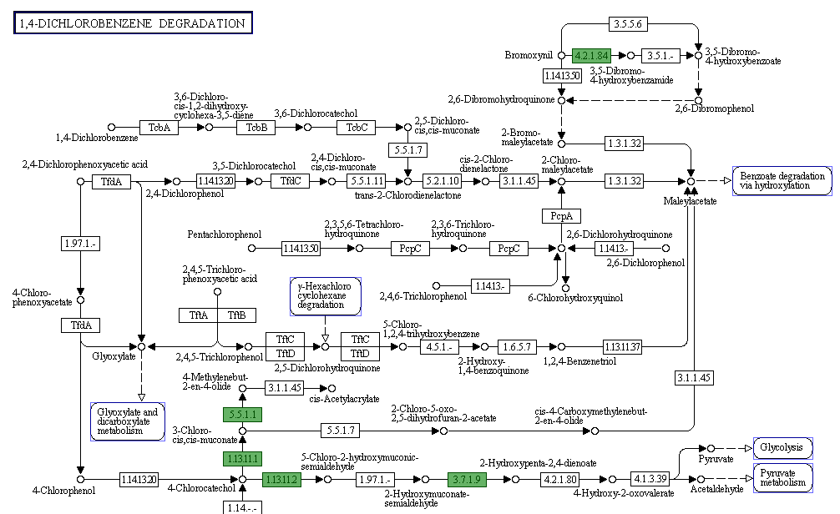
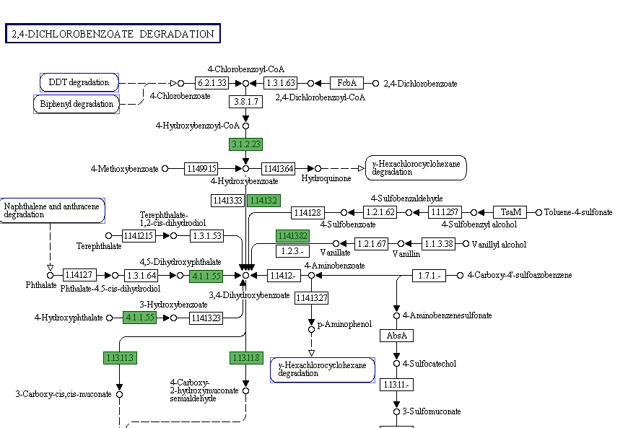
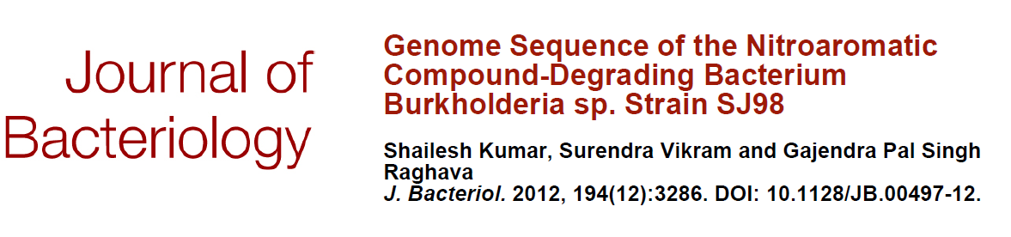

Slide 7
Genome assembly and annotation done at IMTECH
Burkholderia sp. SJ98 (Kumar et al. 2012).
Debaryomyces hansenii MTCC 234 (Kumar et al. 2012).
Imtechella halotolerans K1^{T} (Kumar et al. 2012).
Marinilabilia salmonicolor JCM 21150^{T} (Kumar et al. 2012).
Rhodococcus imtechensis sp. RKJ300 (Vikram et al. 2012).
Rhodosporidium toruloides MTCC 457 (Kumar et al. 2012).

Slide 8
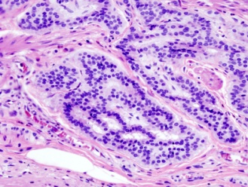
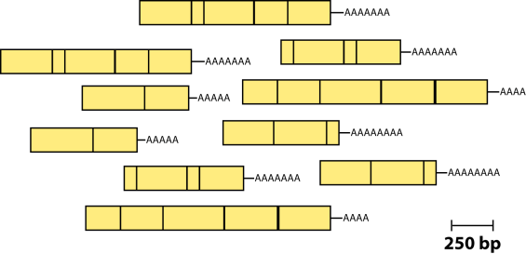
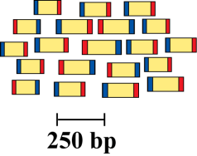
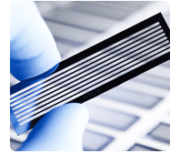
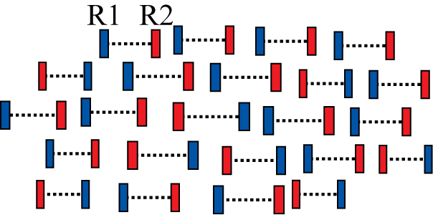
RNA sequencing
RNA-Seq is a recently developed approach to transcriptome profiling that uses deep-sequencing technologies to measure levels of transcripts and their isoforms.
Isolate RNAs
Generate cDNA, fragment, size select, add linkers
Samples of interest
Condition
(colon tumor)
Sequence ends
Map to genome, transcriptome, and predicted exon junctions
100s of millions of paired reads
10s of billions bases of sequence
Downstream analysis

Slide 9
Methods for Protein Analysis
Gel electrophoresis, northern/western blot (fluorescence/radio active label)
Protein microarrays
Mass Spectrometry
X-ray crystallography

Slide 10
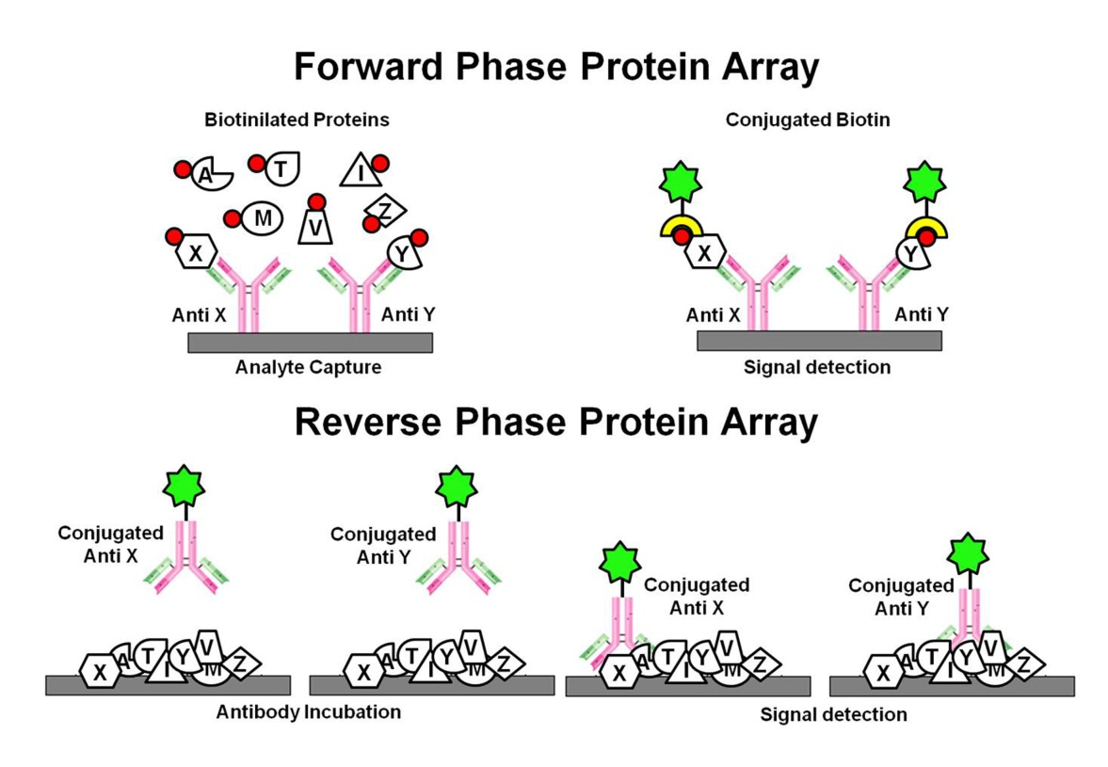

Protein arrays
High throughput analysis of hundreds of thousands of proteins.
Proteins are immobilized on glass chip.
Various probes (protein, lipids, DNA, peptides, etc) are used.
Cons
Require a priori knowledge of the proteins of interest.
Availability of suitable antibodies.
Measure only a small fraction of the proteome

Slide 11
Mass Spectrometry
Find a way to “charge” an atom or molecule (ionization).
Place charged atom or molecule in a magnetic field or electric field and measure its speed or radius of curvature relative to its mass-to-charge ratio (mass analyzer).
Detect ions using microchannel plate or photomultiplier tube(Detection).
Sample
Mass analyzer: separates ions
Mass spectrum
Presents
information
Ion source:
makes ions

Slide 12
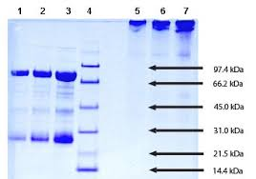
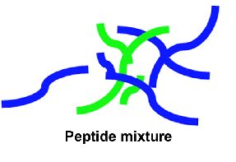
Protein Identification by MS
Spot removed
from gel
Fragmented using trypsin
Spectrum of fragments generated
MATCH
Library
Experimental spectra
Database of sequences
(i.e. SwissProt)
Theoretical
spectra built
Artificially trypsinated

Slide 13
Instrumentation
High Vacuum System
Ion
Source
Mass
Analyzer
Data
System
Inlet
Detector
HPLC
Flow injection
Sample plate
MALDI
ESI
Time of flight (TOF)
Quadrupole
Ion Trap
Magnetic Sector
FTMS
Microchannel Plate
Electron Multiplier
Hybrid with photomultiplier

Slide 14
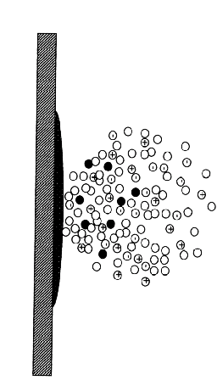
Ion Sources make ions from sample molecules
(Ions are easier to detect than neutral molecules.)
Electrospray ionization
MALDI
Sample plate
Sample Inlet Nozzle
(Lower Voltage)
Partial
vacuum
Pressure = 1 atm
Inner tube diam. = 100 um
Laser
N₂
MH⁺
+
+
+
+
+
+
+
+
+
+
+
+
+
+
+
+
+
+
+
MH₂⁺
+
+
+
Sample in solution
+
+
+
MH⁺
+
+
+
+
+
+
+
+
+
+
+
+
+
+
+
N₂ gas
+
+
+
+
+
+
MH₃⁺
High voltage applied
to metal sheath (~4 kV)
Charged droplets
Grid (0 V)
+/- 20 kV

Slide 15
Mass analyzers separate ions based on their
mass-to-charge ratio (m/z)
Operate under high vacuum (keeps ions from bumping into gas molecules)
Actually measure mass-to-charge ratio of ions (m/z)
Key specifications are resolution, mass measurement accuracy, and sensitivity.
Several kinds exist: for bioanalysis, quadrupole, time-of-flight and ion traps are most used.

Slide 16
Tandem Mass Spectrometry
LC
MS
collision
cell
MS-1
MS-2
MS/MS
Ion
Source
Parent
Ions
Fragment
Ions

Slide 17
What’s in a Mass Spectrum?
Fragment Ions
Derived from molecular ion or higher weight fragments
Ion Abundance (as a %of Base peak)
“molecular ion”
In molecular ions, adduct ions, [M+reagent gas]⁺
High mass
Mass, as m/z. Z is the charge, and for doubly charged ions (often seen in macromolecules), masses show up at half their proper value
Notes:
he term “adduct ion” is a popular term among liquid chromatography/mass spectrometry (LC/MS) users to describe ions formed by adduction of alkali metal ions to an analyte molecule in positive ion analysis. However, the well-informed user should be aware that “adduct ion” correctly refers to any ion formed by adduction of an ionic species to a molecule. Therefore, the common protonated molecule or [M+H]⁺ is also properly called an adduct ion. In our column this month we will be discussing specifically the adduction of alkali metal ions (Na, K), to analyte molecules and will therefore use the term “metal adduct ion” to refer to these species.

Slide 18
Peptide Fragmentation
H...-HN-CH-CO-NH-CH-CO-NH-CH-CO-…OH
R_{i-1}
R_{i}
R_{i+1}
N-terminus
C-terminus
AA residue_{i-1}
AA residue_{i}
AA residue_{i+1}
Collision Induced Dissociation
H⁺
H...-HN-CH-CO . . . NH-CH-CO-NH-CH-CO-…OH
R_{i-1}
R_{i}
R_{i+1}
Prefix Fragment
Suffix Fragment
Peptides tend to fragment along the backbone.
Fragments can also loose neutral chemical groups like NH₃ and H₂O.

Slide 19
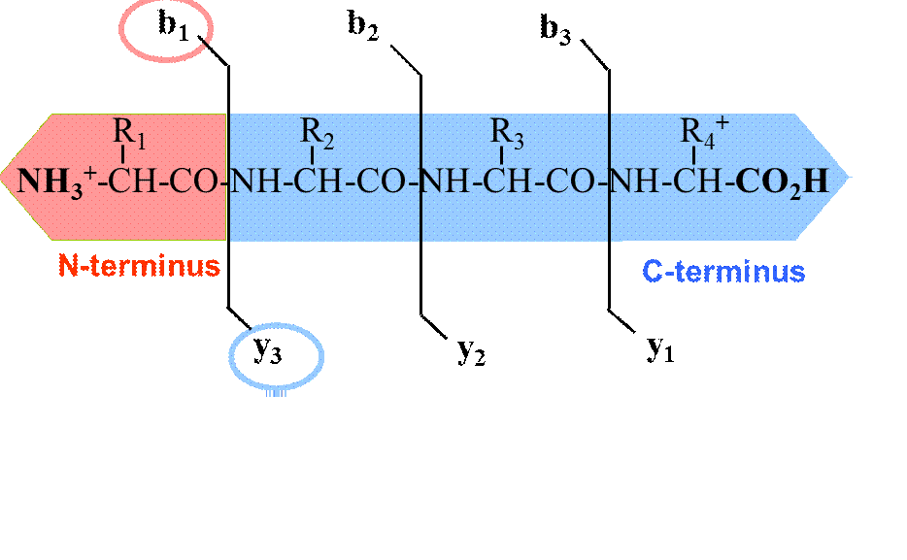
B ions and Y ions
http://www.molgen.mpg.de/101151/Proteomics

Slide 20
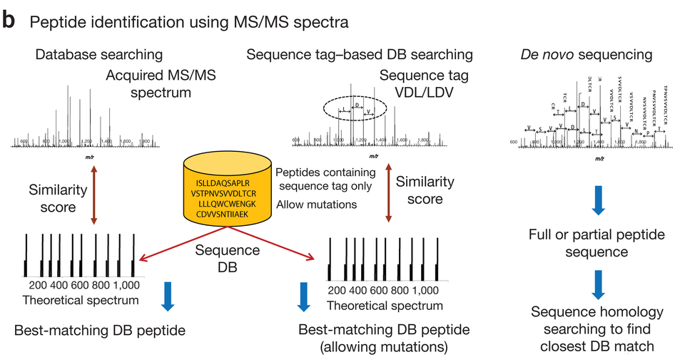
Mass spectra searching techniques

Slide 21
Open Database search tools
Commercial Software
SEQUEST (Yates et al., 1995)
MASCOT (Perkins, Pappin, Creasy, & Cottrell, 1999)
Myrimatch
X!Tandem
MSGF
OMSSA
More accurate than Mascot and sequest (Kim & Pevzner, 2014)

Slide 22
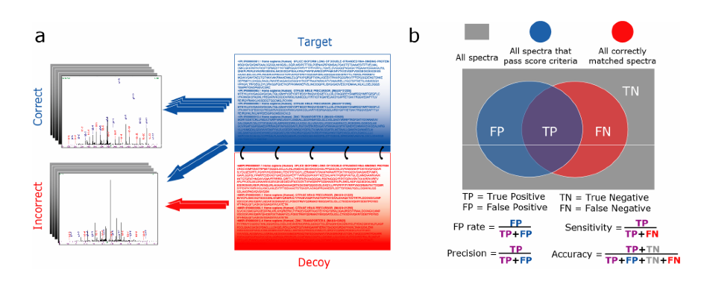
Target-Decoy Search Strategy for Mass Spectrometry-Based Proteomics
incorrect “decoy” sequences added to the search space will correspond with incorrect search results that might otherwise be deemed to be correct.
Mass spectrum
Proportion of matches in decoy database represent false matches
Target and reversed Decoy database

Slide 23
Applications
Analyzing Protein Modifications
  Finding all modifications on a single protein
  Proteome wide scanning of modifications
Protein Profiling
  Generate large scale proteome maps
  Annotate and correct genomic sequences
  Analyze protein expression as a function of cellular state
Detection of amino acid substitutions
Protein sample identification/confirmation
Protein sample purity determination

Slide 24
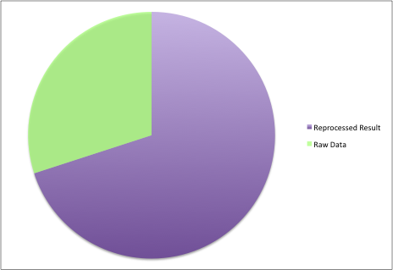
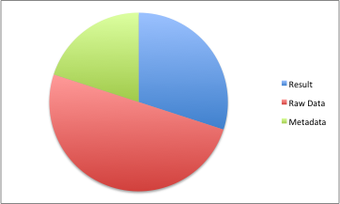
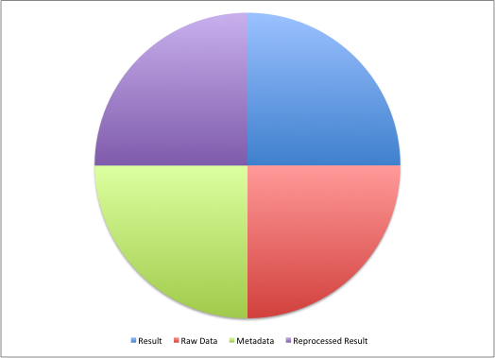
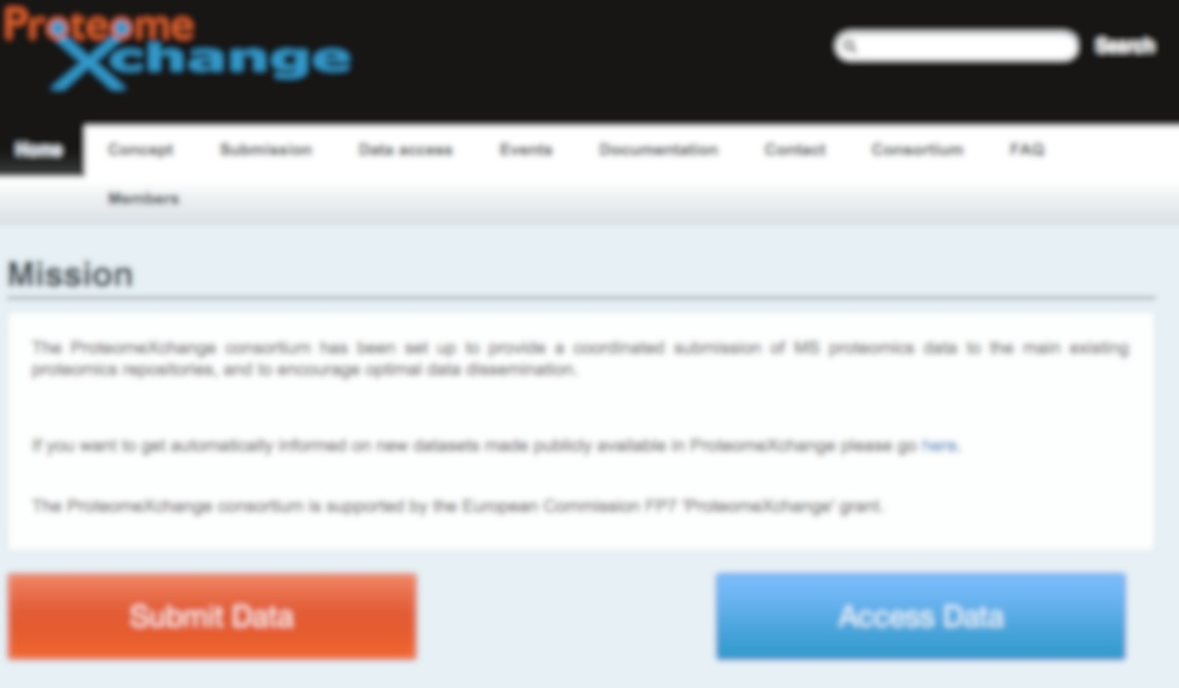
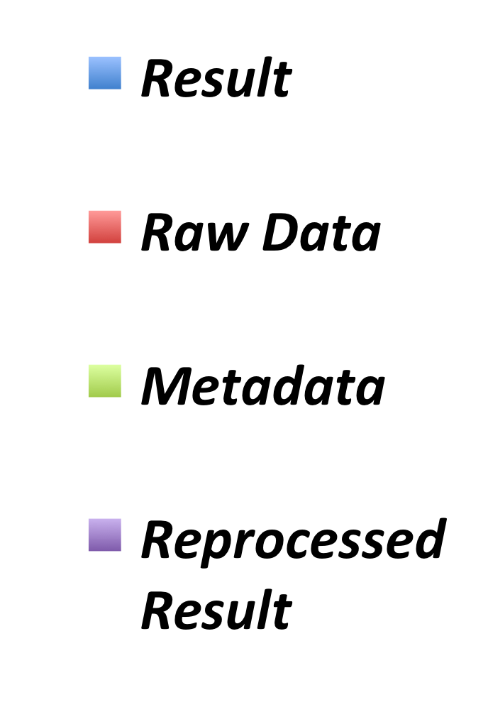
Major Proteomics Repositories
Repositories
PeptideAtlas
PRIDE
RAW
DATA
UniProt
NextProt
PASSEL
Proteome
Central
Other DBs
JOURNALS
Other DBs
GPMDB

Slide 25
Major Challenge
Large number of
unidentified spectra
May be peptides are missing in the database searched…..
Are all the reference databases complete ???

Slide 26
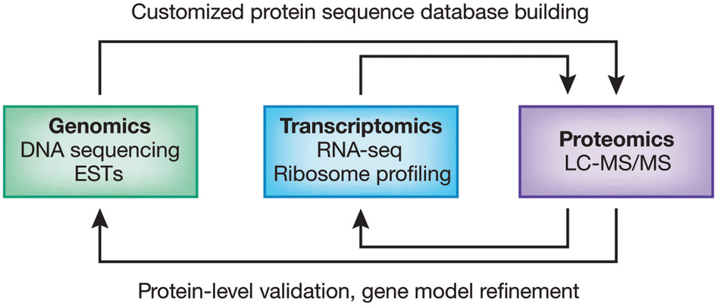
Proteogenomics
Term coined in the literature in 2004.
Genomic for generating customized databases.
Identify novel peptides.
Disease biomarkes based on novel mutation
Notes:
n a proteogenomic approach, genomic and transcriptomic data are used to generate customized protein sequence databases to help interpret proteomic data. In turn, the proteomic data provide protein-level validation of the gene expression data and help refine gene models. The enhanced gene models can help improve protein sequence databases for traditional proteomic analysis.

Slide 27

Proteomics
Non-Tumor Sample
intensity
Searched
against
Refseq
Uniprot
mass/charge
Aberrant proteins
Tumor
Sample
Variant proteins
intensity
Fusion proteins
mass/charge
Proteogenomics
Non-Tumor Sample
intensity
Genome sequencing
Germline variants
mass/charge
RNA-Seq
Alternative splicing,
somatic variants, expression
Tumor Sample
intensity
Tumor Specific
Protein DB
mass/charge

Slide 28
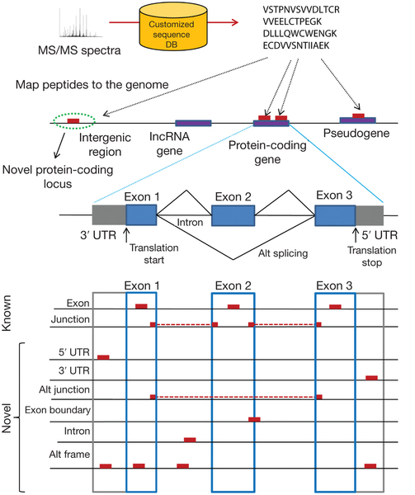
TYPES OF PEPTIDES IDENTIFIED IN PROTEOGENOMICS
Novel Peptides mapping on Non Coding Region
Novel Peptides mapping on Non Coding Region
5’UTR
3’UTR
Novel Junctions
Intergenic peptides
Alternating Reading Frame

Slide 29
Methods of generation of customized databases
6 Frame Translation of
Reference Database
Perl or python scripts
Ab initio gene prediction.
Perl and python scripts
RNA-seq data
CustomProdb, Galaxy-P system, sapFinder
Whole genome Sequencing
Peppy
Other Databases
OMIM, neXtProt, Ecgene, ChimerDB, COSMIC

Slide 30
What does proteogenomics offer?
Genomics
Proteomics
Transcriptomics
Novel Exons
Novel N termini
Novel signal peptide
Novel Junctions
Variant peptides
Novel ORFs
Novel signal peptide cleavage sites

Slide 31
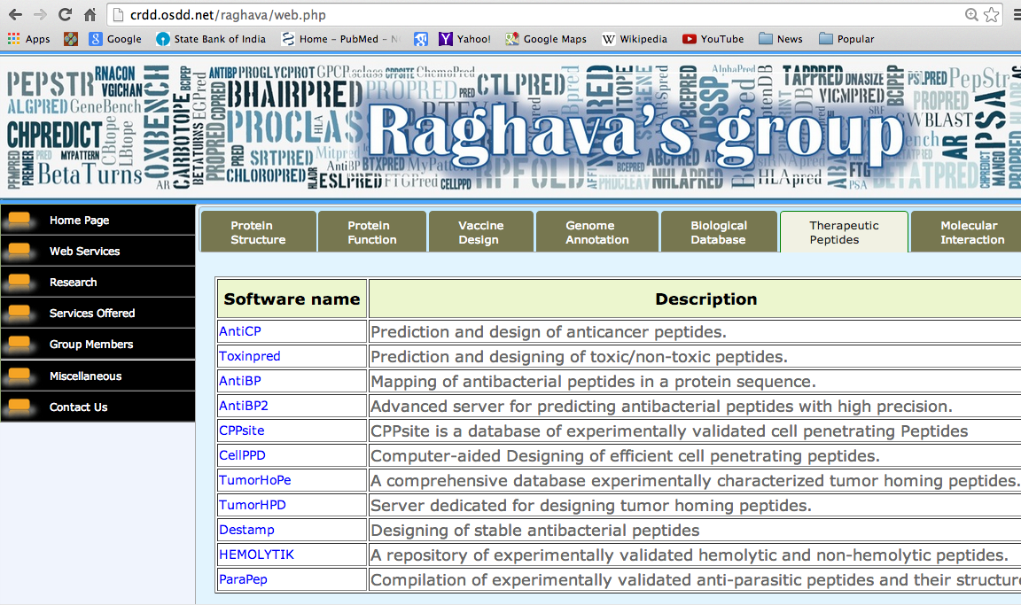
Open source Web Services

Slide 32
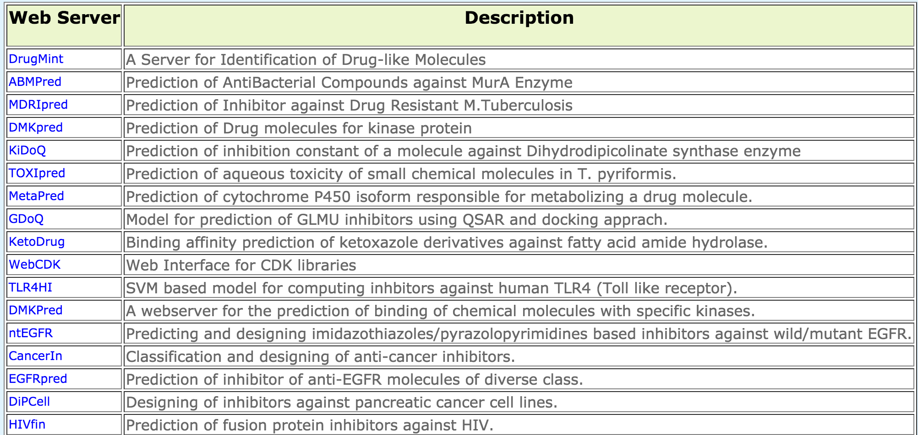
Chemoinformatics and Pharmacoinformatics

Slide 33
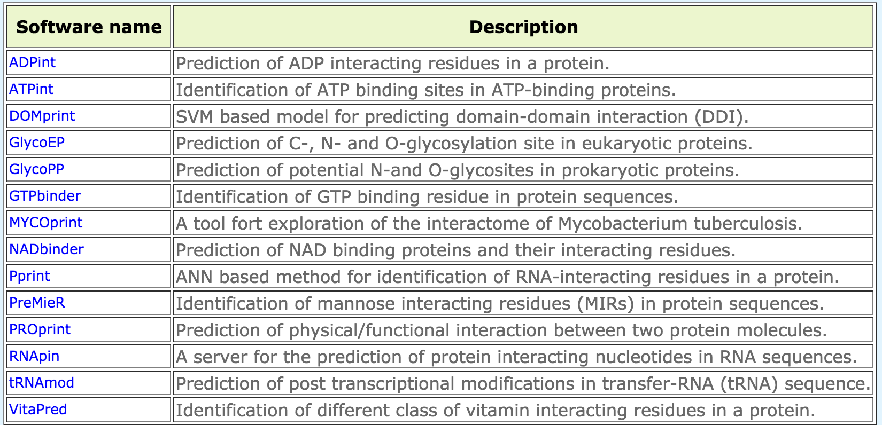
Molecular Interactions

Slide 34
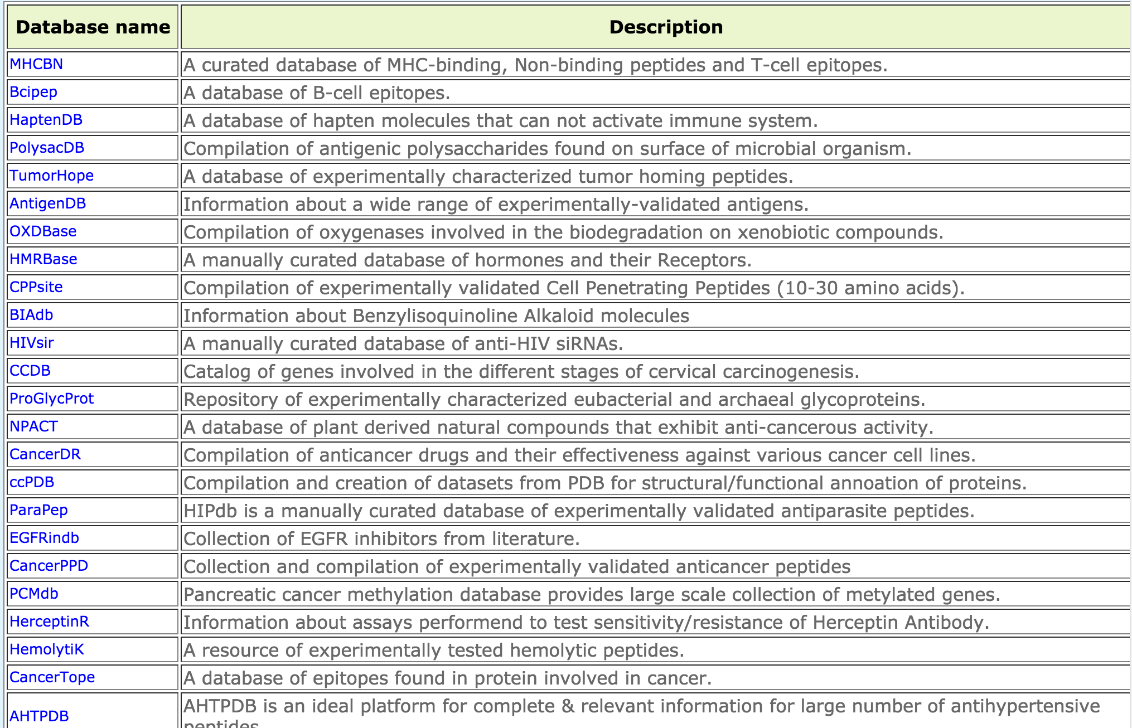
Biological Databases

Slide 35
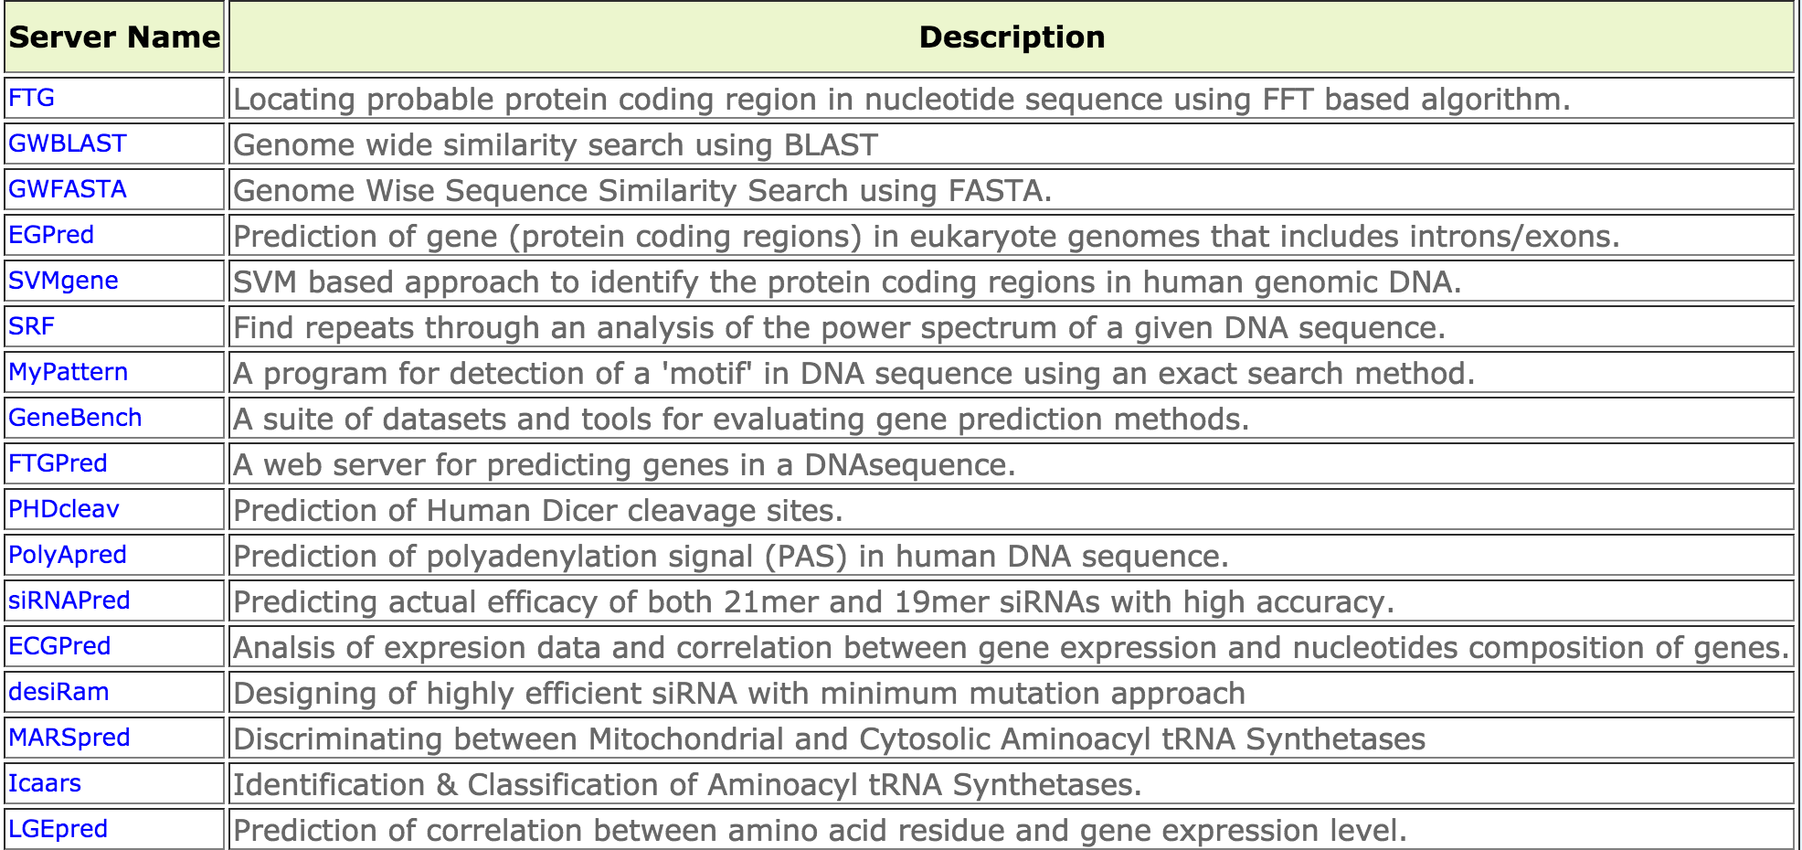
Genome Annotations

Slide 36
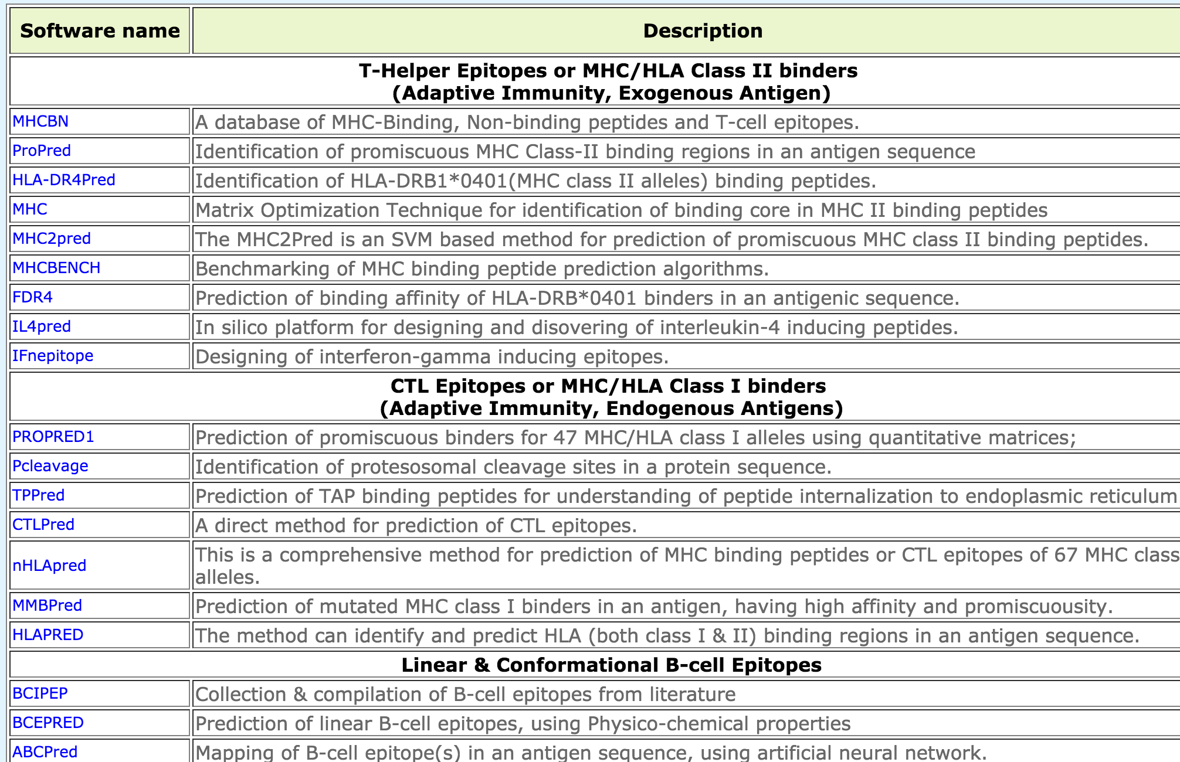
Immunoinformatics or Vaccine Informatics

Slide 37
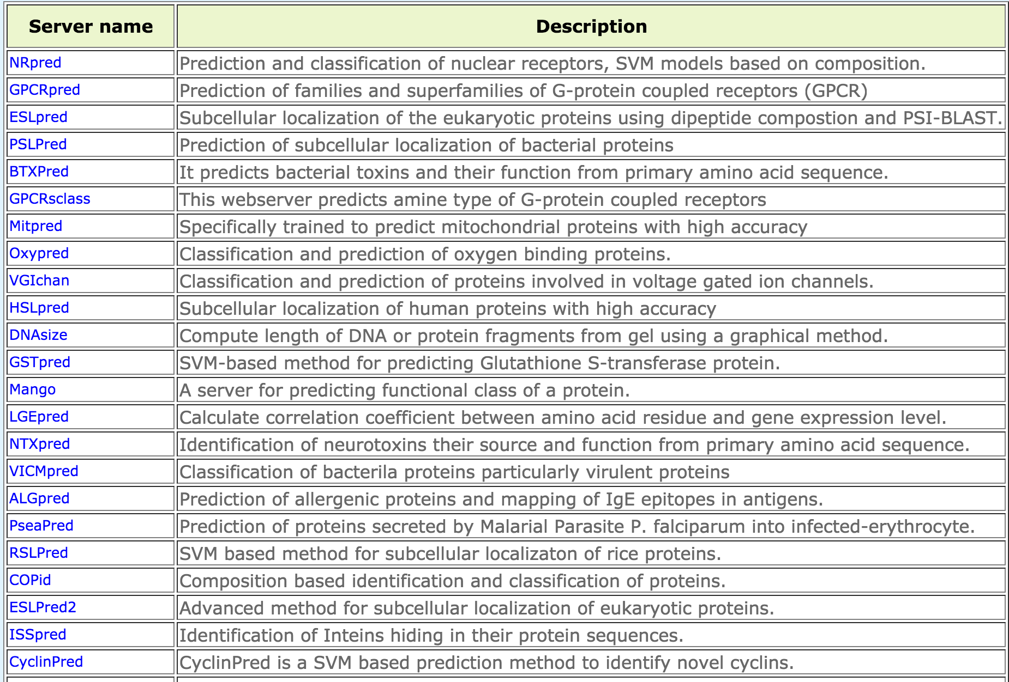
Functional Annotation of Proteins

Slide 38
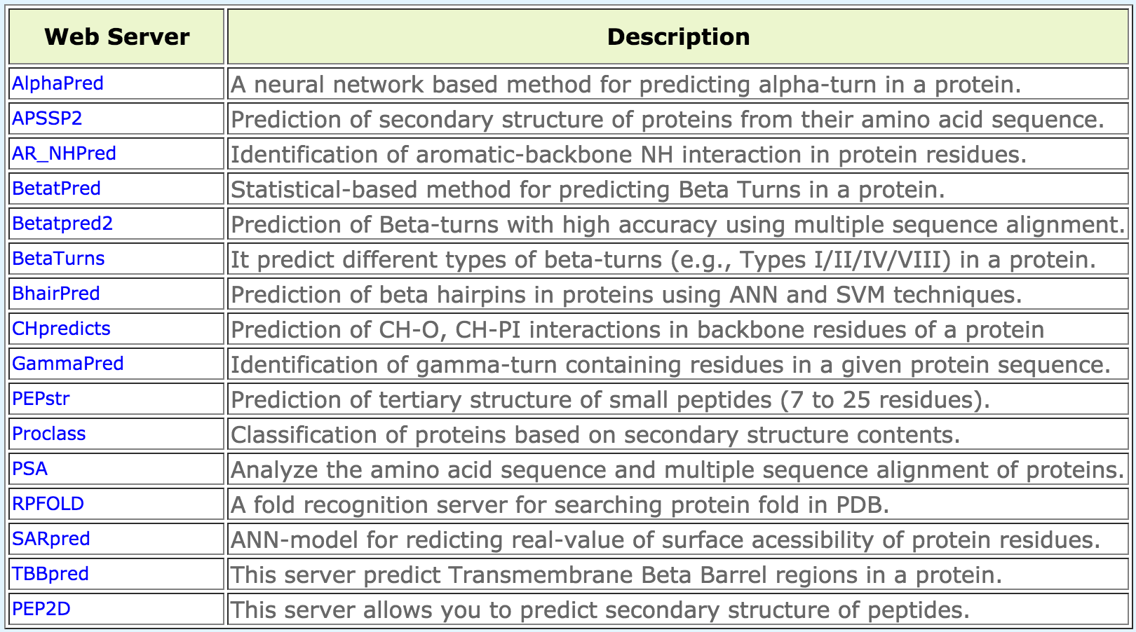
Proteins Structure Prediction

Slide 39
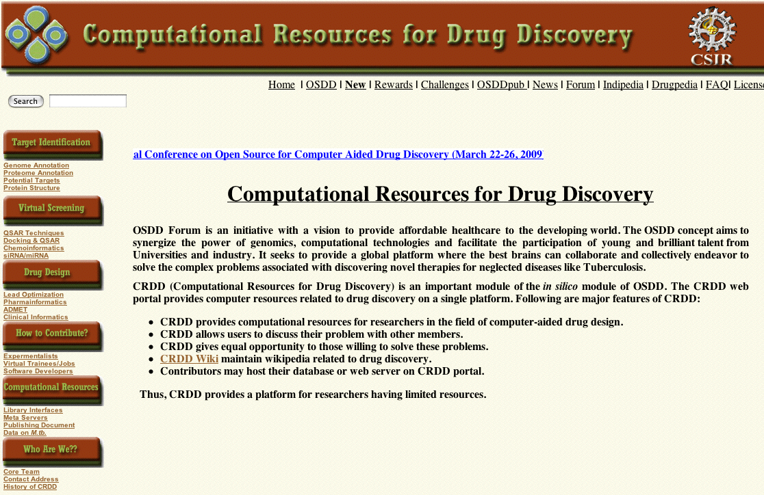

Slide 40
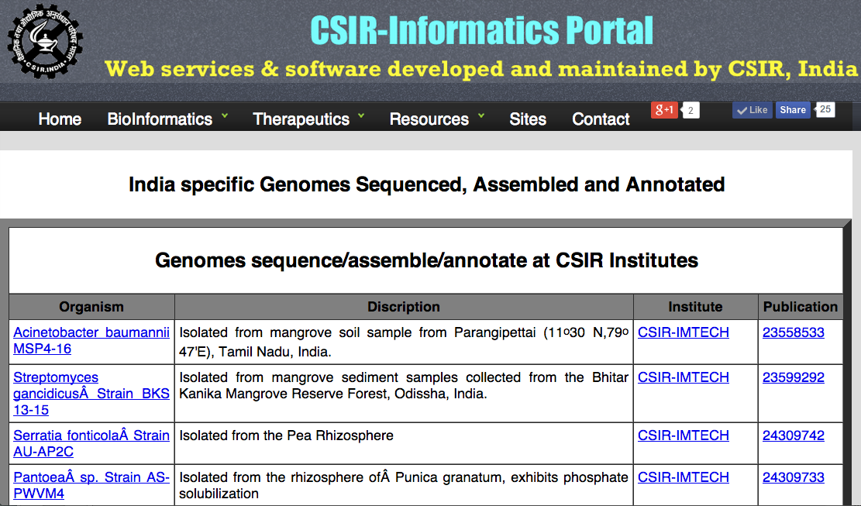

Slide 41
GPSR: A Resource for Genomics Proteomics and Systems Biology
A journey from simple computer programs to drug/vaccine informatics
Limitations of existing web services
  History repeats (Web to Standalone)
  Graphics vs command mode
General purpose programs
  Small programs as building unit
Integration of methods in GPSR

Slide 42
Types of Prediction Methods

Slide 43
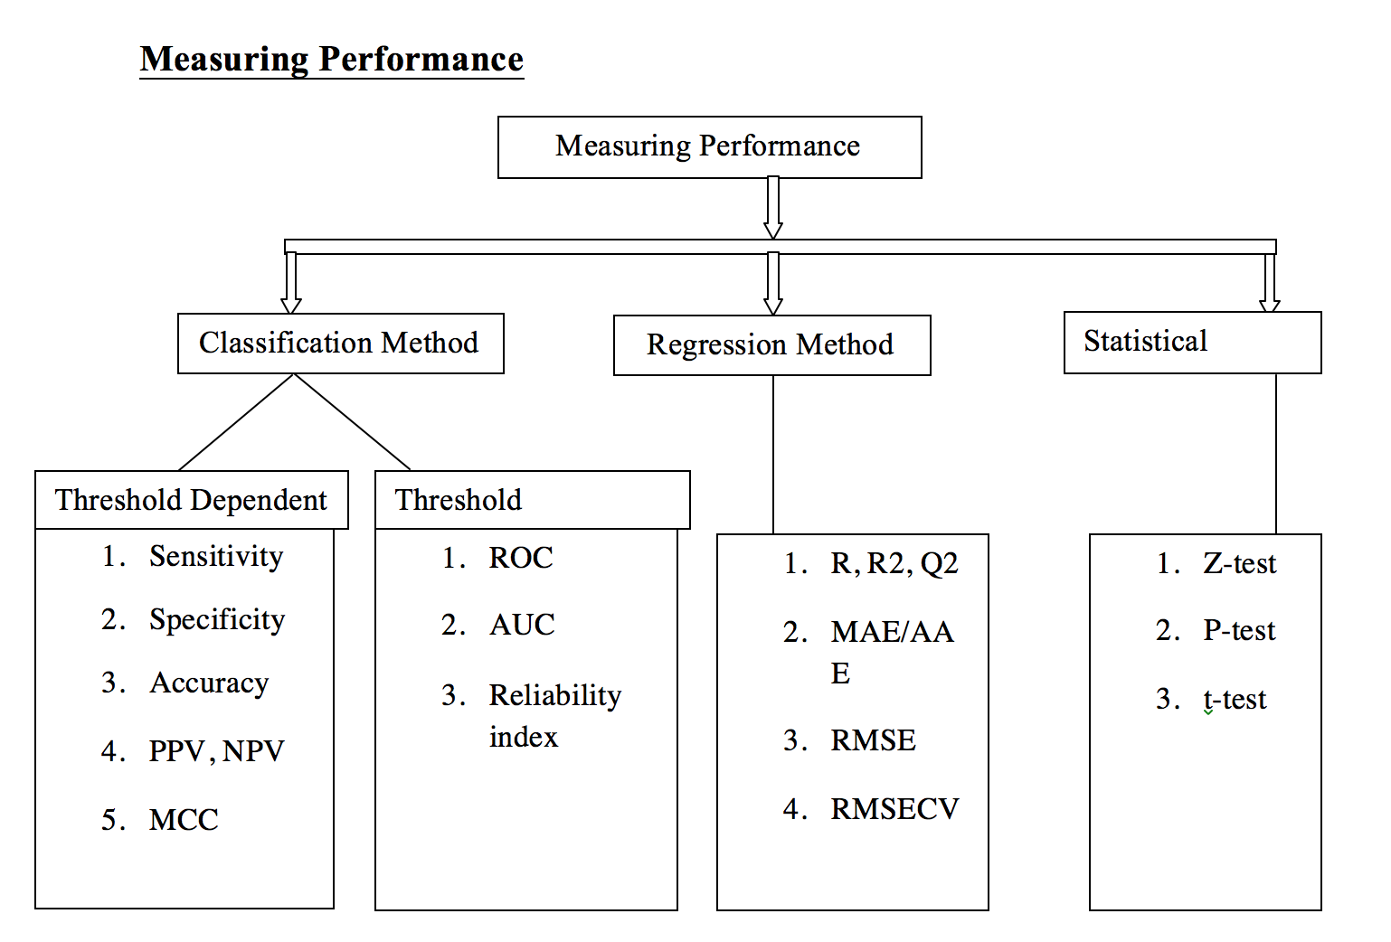

Slide 44
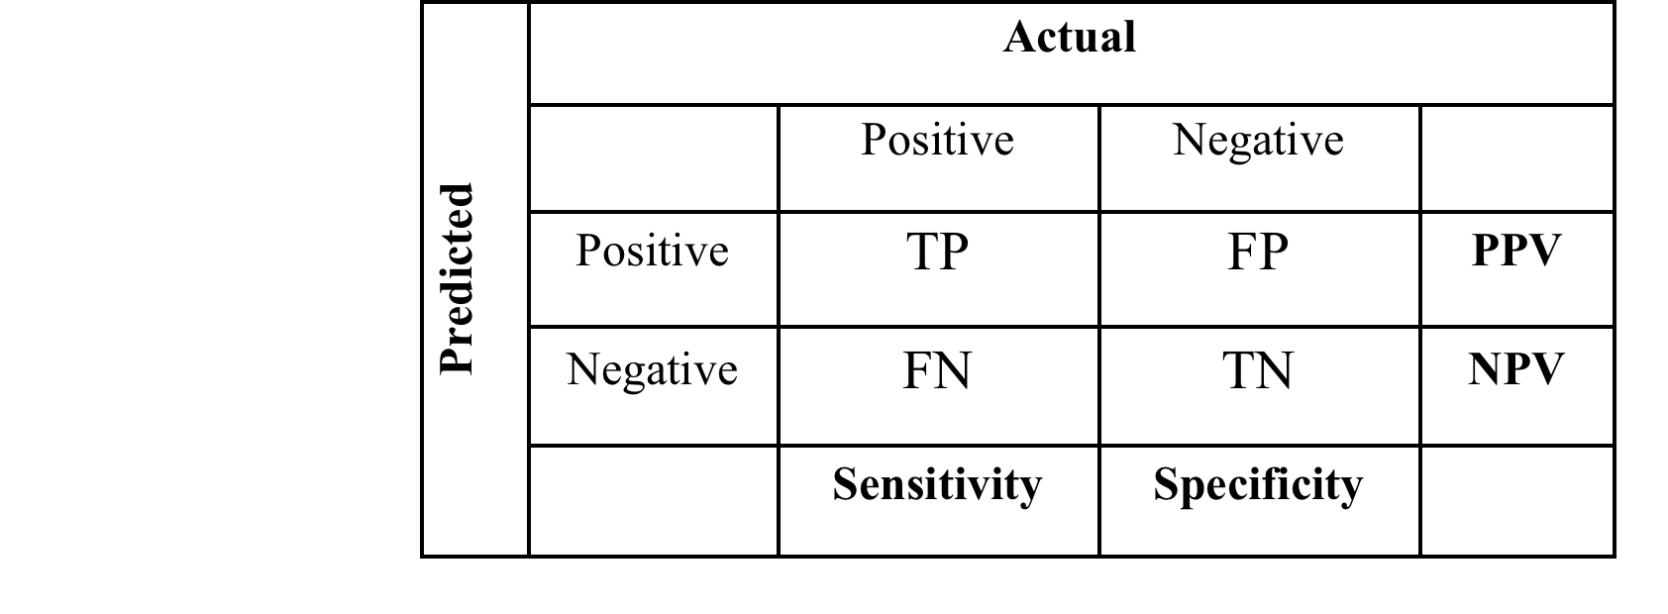

Slide 45
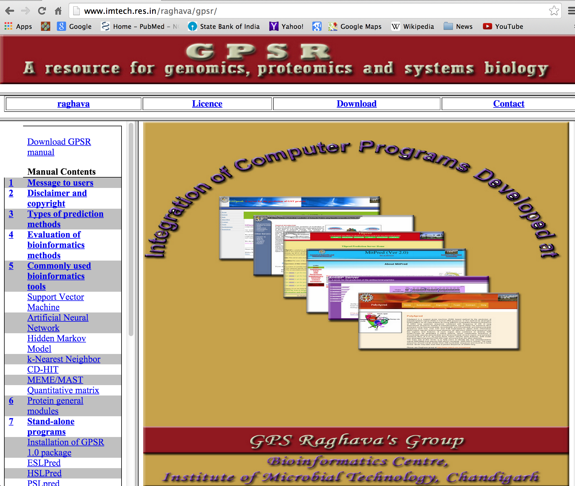

Slide 46



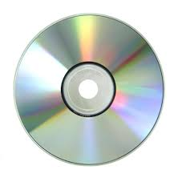
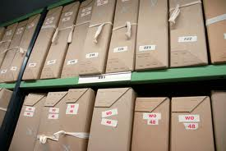




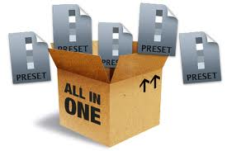
OSDDLINUX
Customized operating environment for drug discovery pipeline
Bioinformatics
Live Server
VACCINE Informatics
Live CD
ChemInformatics
Pkg Repository
Installation
Webserver
Standalone
Galaxy platform
All in ONE

Slide 47
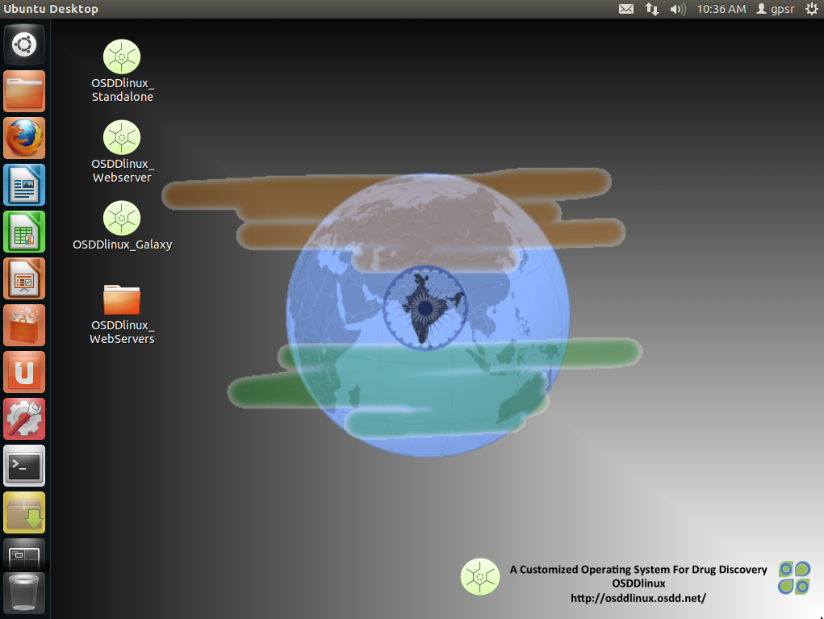
Osddlinux desktop is ready for use.
Password for sudo : osddlinux root : osddlinux
Osddlinux installation on system hard drive

Slide 48





Operating System for Drug Discovery

Slide 49


Slide 50


Slide 51


