Slide 1

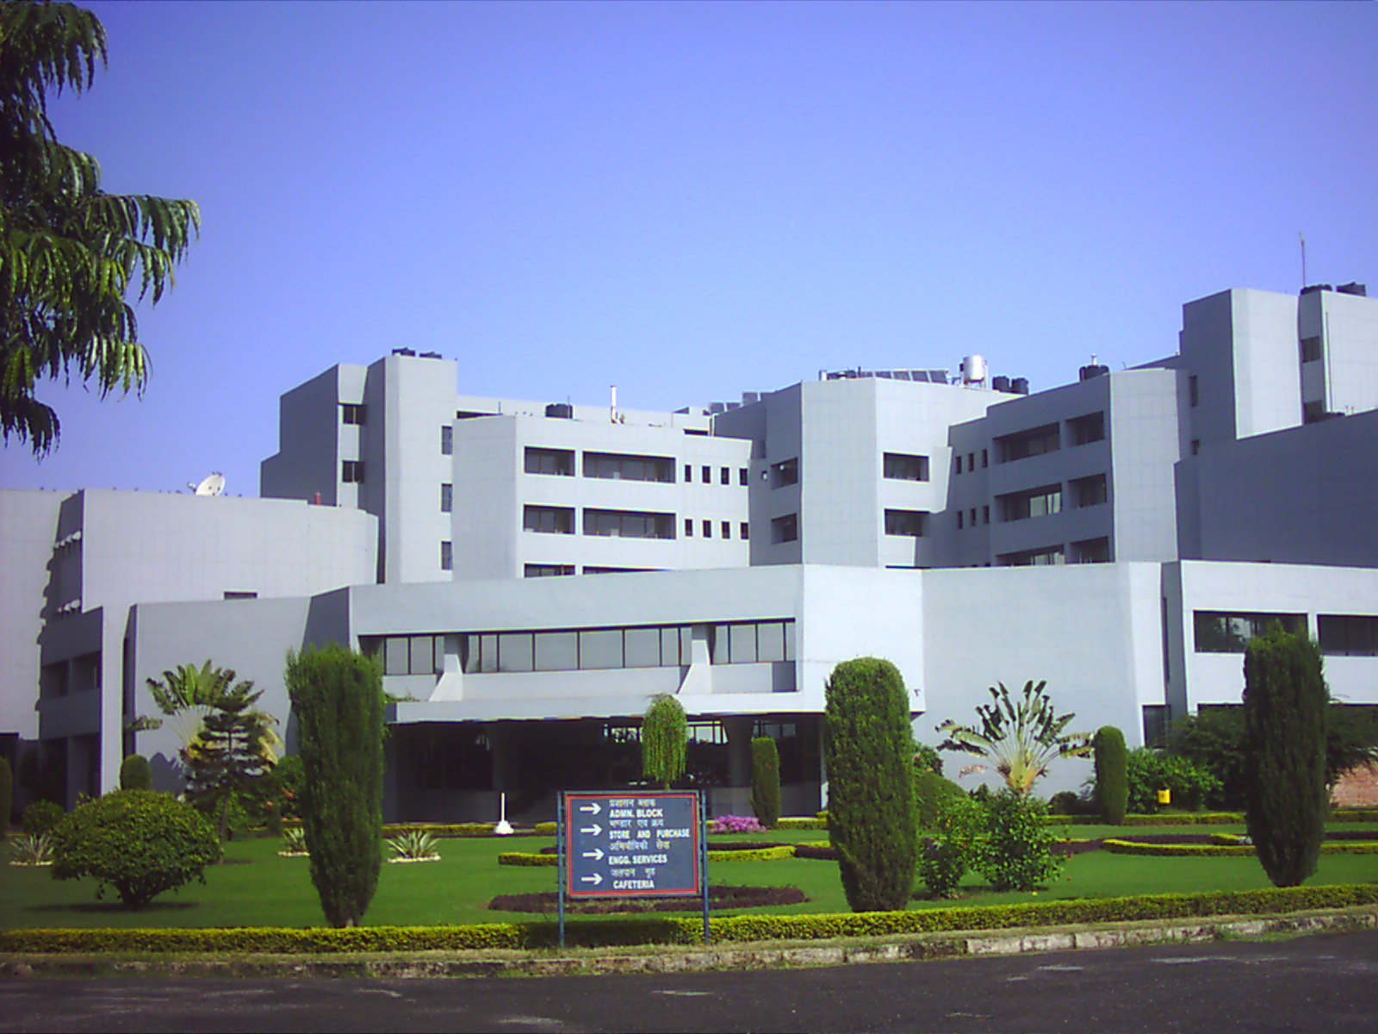
OSDDlinux: Operating System for Drug Discovery
Dr G P S Raghava, Head Bioinformatics Centre
Institute of Microbial Technology, Chandigarh, India
Bioinformatics Drug Informatics Vaccine Informatics Chemoinformatics
Email: raghava@imtech.res.in http://osddlinux.osdd.net/
http://ww.imtech.res.in/raghava/

Slide 2
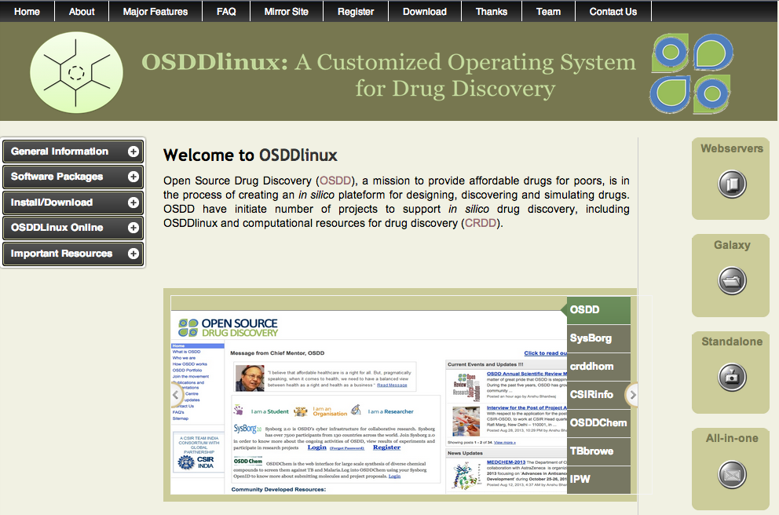

Slide 3



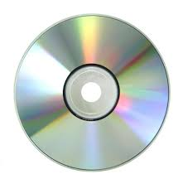
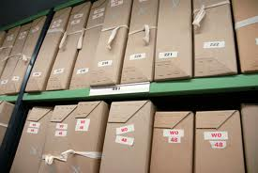




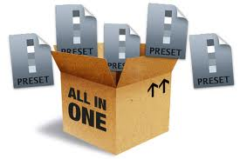
OSDDLINUX
Customized operating environment for drug discovery pipeline
Bioinformatics
Live Server
VACCINE Informatics
Live CD
ChemInformatics
Pkg Repository
Installation
Webserver
Standalone
Galaxy platform
All in ONE

Slide 4
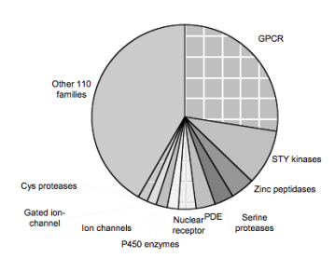
Computer-Aided Drug Discovery
Searching Drug Targets: Bioinformatics
Genome Annotation
FTGpred: Prediction of Prokaryotic genes
EGpred: Prediction of eukaryotic genes
GeneBench: Benchmarking of gene finders
SRF: Spectral Repeat finder
Comparative genomics
GWFASTA: Genome-Wide FASTA Search
GWBLAST: Genome wide BLAST search
COPID: Composition based similarity search
LGEpred: Gene from protein sequence
Subcellular Localization Methods
PSLpred: localization of prokaryotic proteins
ESLpred: localization of Eukaryotic proteins
HSLpred: localization of Human proteins
MITpred: Prediction of Mitochndrial proteins
TBpred: Localization of mycobacterial proteins
Prediction of drugable proteins
Nrpred: Classification of nuclear receptors
GPCRpred: Prediction of G-protein-coupled receptors
GPCRsclass: Amine type of GPCR
VGIchan: Voltage gated ion channel
Pprint: RNA interacting residues in proteins
GSTpred: Glutathione S-transferases proteins
Protein Structure Prediction
APSSP2: protein secondary structure prediction
Betatpred: Consensus method for β-turns prediction
Bteval: Benchmarking of β-turns prediction
BetaTurns: Prediction of -turn types in proteins
Turn Predictions: Prediction of α/ β/γ -turns in proteins
GammaPred: Prediction of-turns in proteins
BhairPred: Prediction of Beta Hairpins
TBBpred: Prediction of trans membrane beta barrel proteins
SARpred: Prediction of surface accessibility (real accessibility)
PepStr: Prediction of tertiary structure of Bioactive peptides

Slide 5
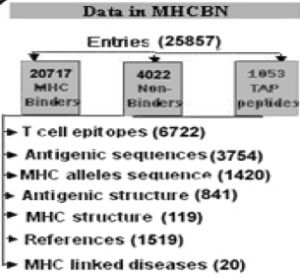
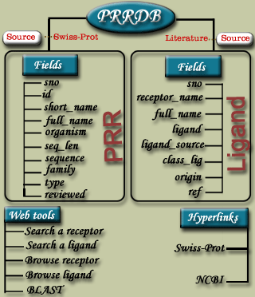
Modelling of Immune System for Designing Epitope-based Vaccines
Adaptive Immunity (Cellular Response) : T_{helper} Epitopes
Propred: for promiscuous MHC II binders
MMBpred:for high affinity mutated binders
MHC2pred: SVM based method
MHCBN: A database of MHC/TAP binders and non-binders
Pcleavage: for proteome cleavage sites
TAPpred: for predicting TAP binders
Propred1: for promiscuous MHC I binders
CTLpred: Prediction of CTL epitopes
Adaptive Immunity (Cellular Response) : CTL Epitopes
BCIpep: A database of B-cell eptioes;
ABCpred: for predicting B-cell epitopes
ALGpred: for allergens and IgE eptopes
HaptenDB: A datbase of haptens
Adaptive Immunity (Humoral Response) :B-cell Epitopes
Innate Immunity : Pathogen Recognizing Receptors and ligands
PRRDB: A database of PRRs & ligands
Antibp: for anti-bacterial peptides
Signal transduction in Immune System
Cytopred: for classification of Cytokines

Slide 6
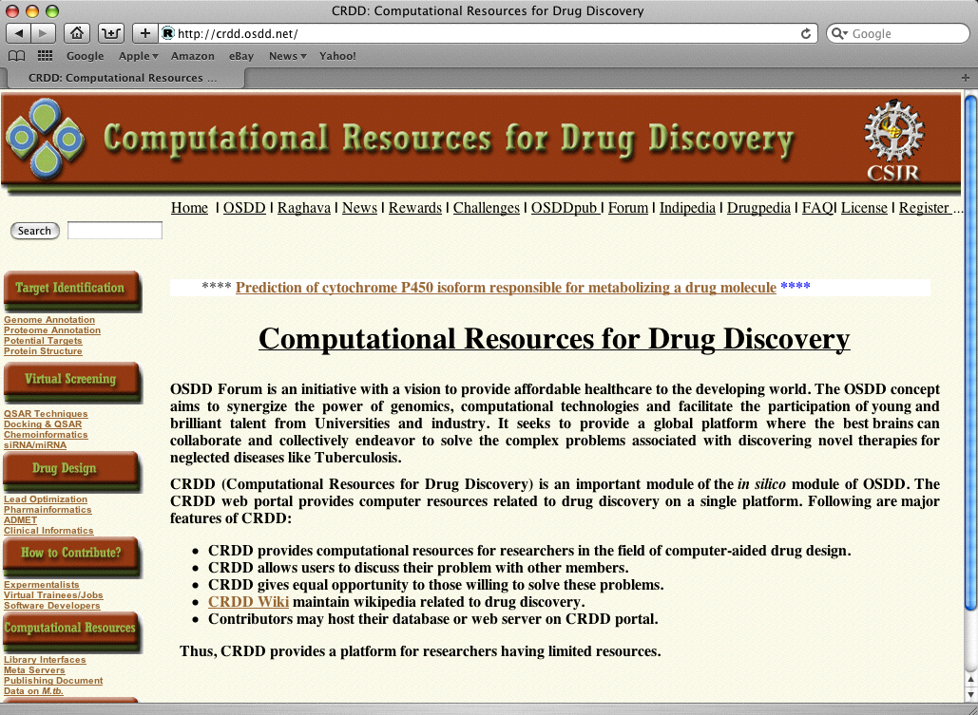

Slide 7
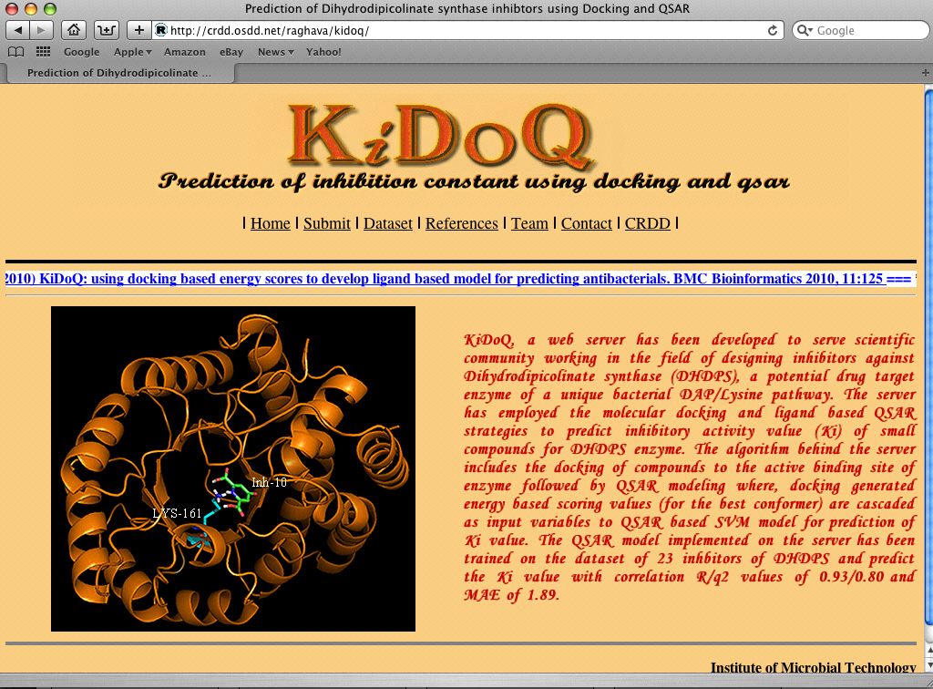

Slide 8
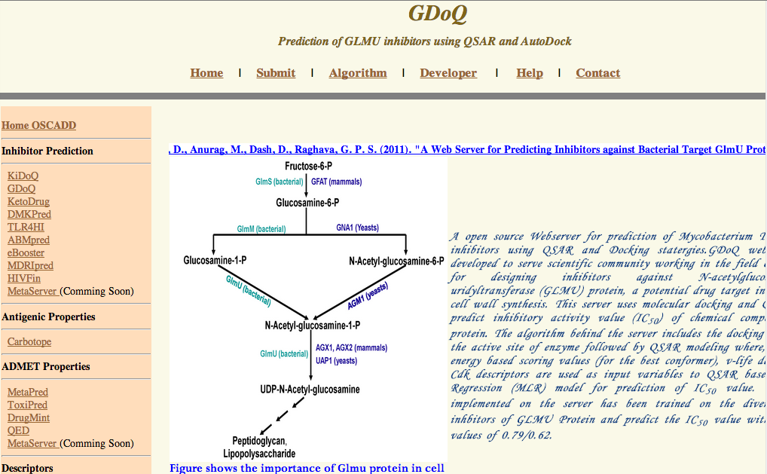

Slide 9
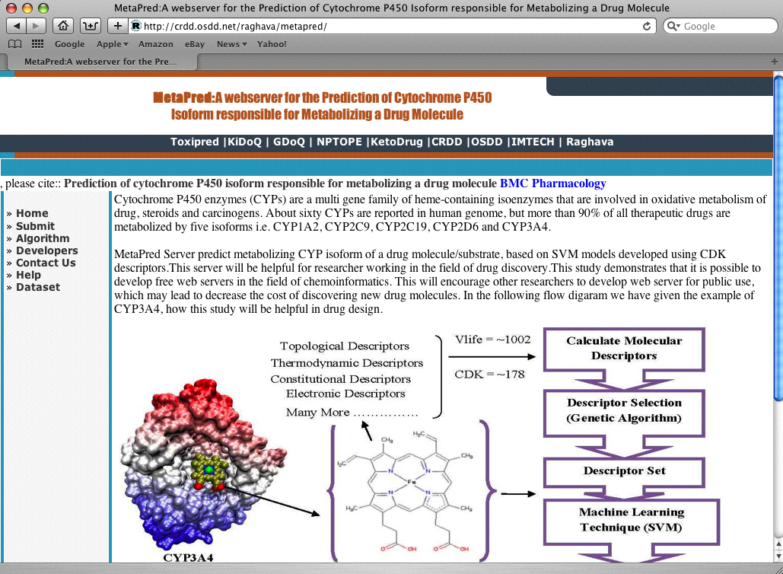

Slide 10
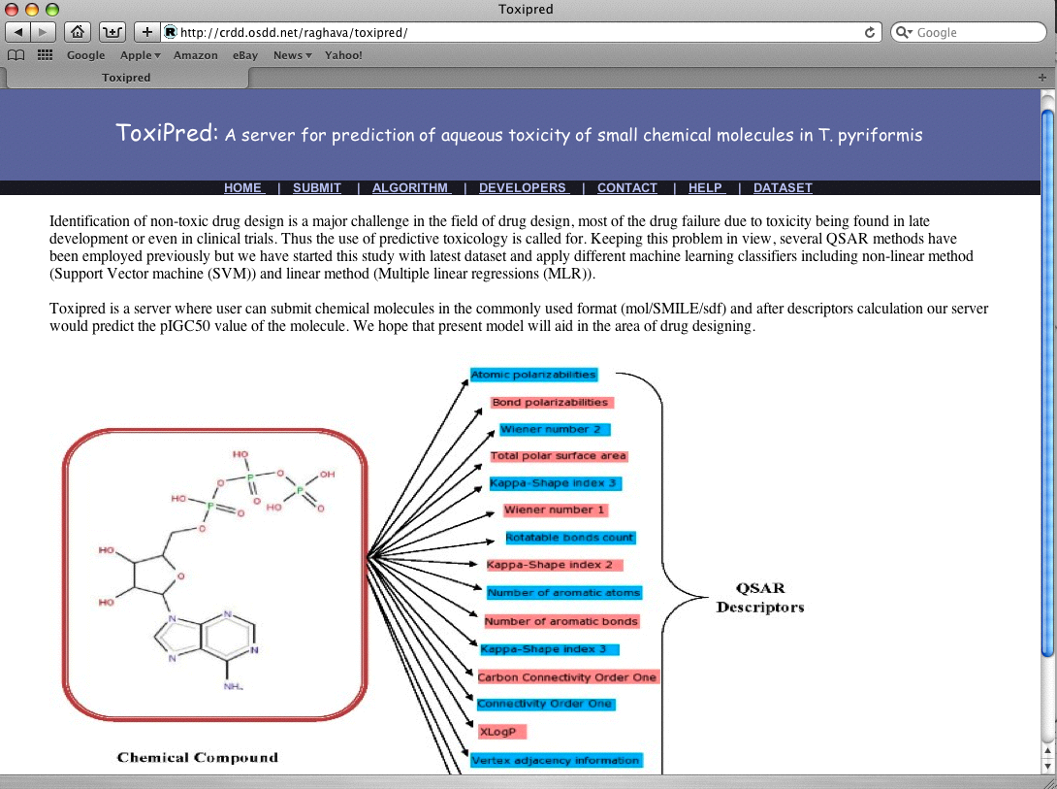

Slide 11
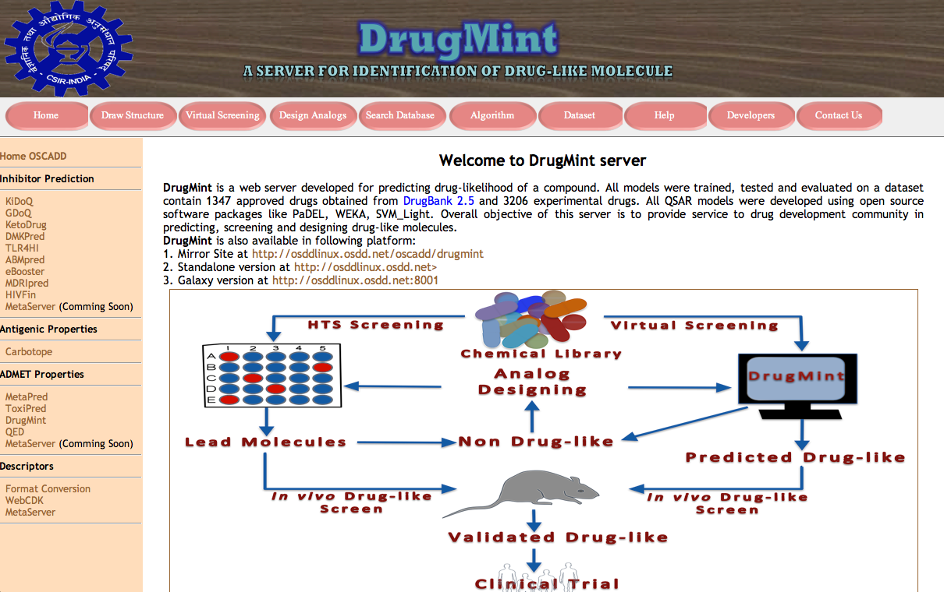

Slide 12
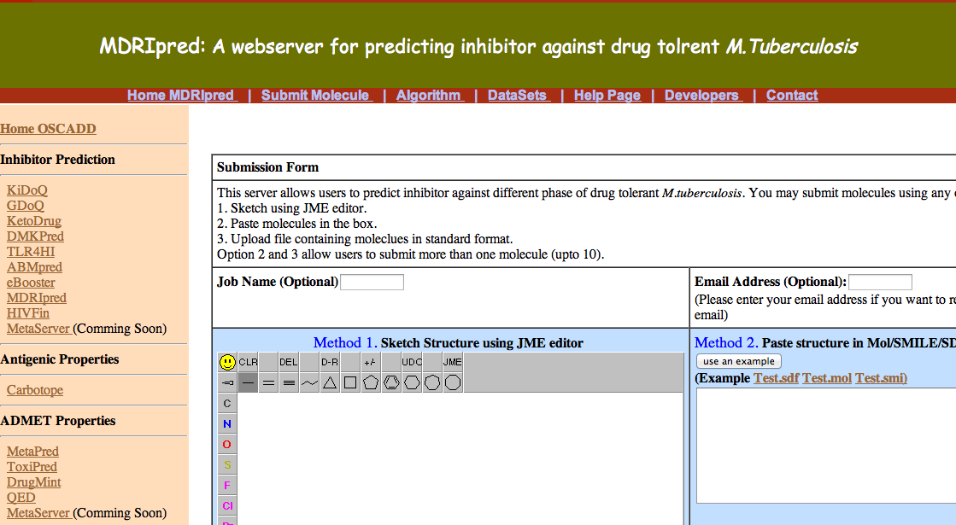

Slide 13
Limitations of existing web services
Uploading or downloading large data
Serving too many user from single source
Difficult to provide computer intensive job
Depend on internet and its bandwidth
Security of data in transition
Maintain confidentiality of data
Difficult to analyze graphical data

Slide 14
GPSR: A Resource for Genomics Proteomics and Systems Biology
A journey from simple computer programs to drug/vaccine informatics
Limitations of existing web services
  History repeats (Web to Standalone)
  Graphics vs command mode
General purpose programs
  Small programs as building unit
Integration of methods in GPSR

Slide 15
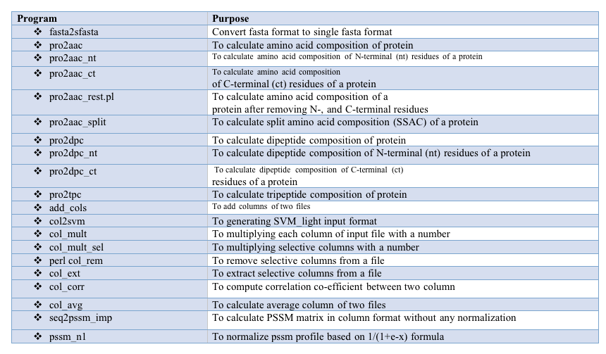
Thankyou

Slide 16
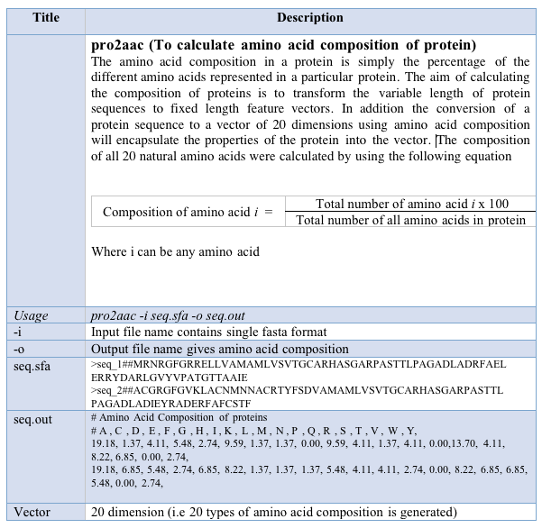
Thankyou

Slide 17
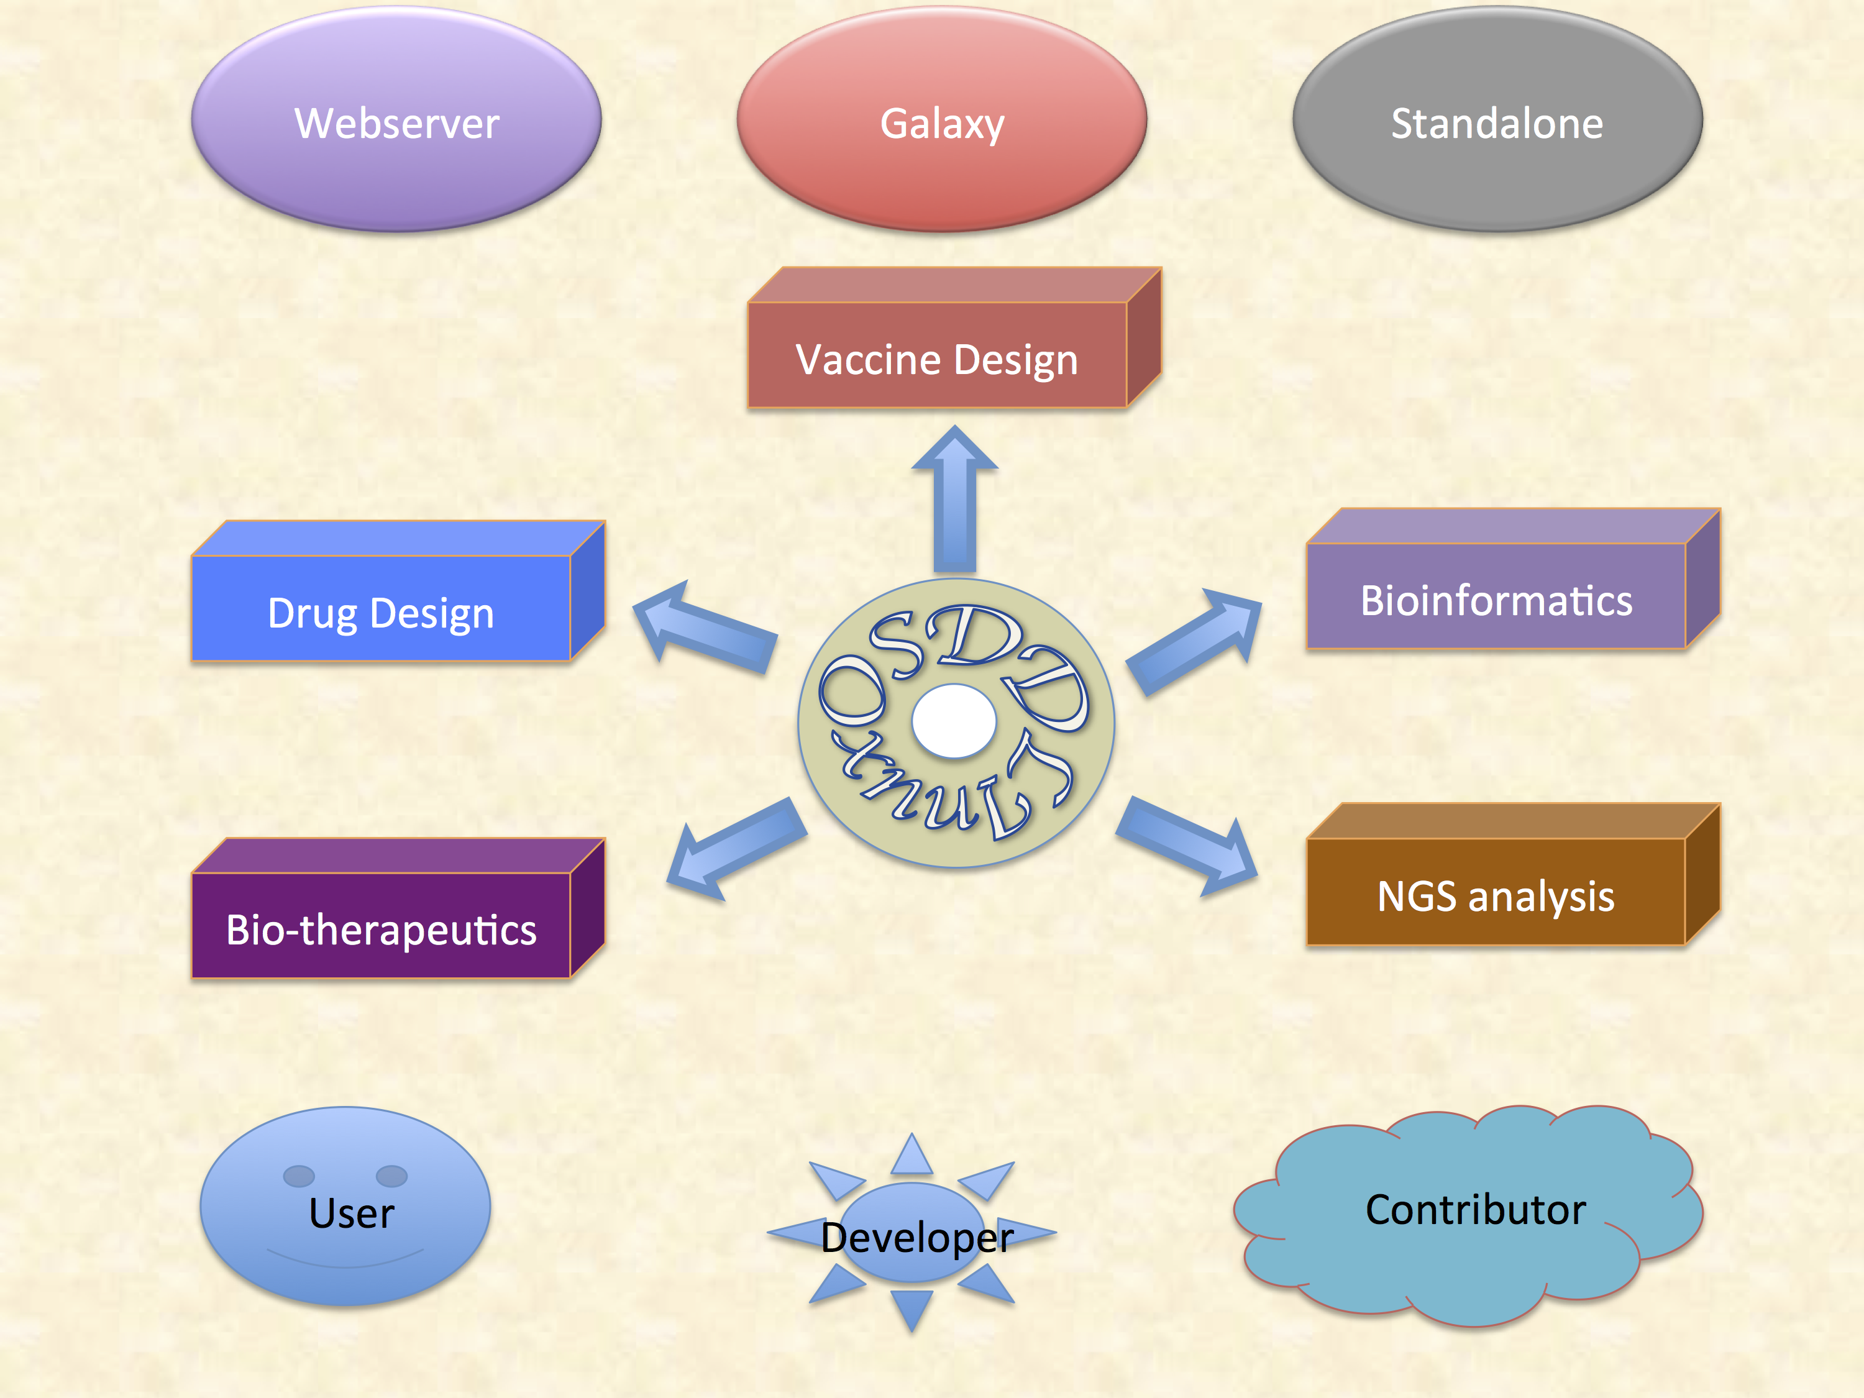

Slide 18
Major Features of OSDDlinux
Service for Scientific Community
Online for Occasional Users
LiveDVD/USB on local computer with Data Security
Platform for Developers
Developers with no infrastructure
Infrastructure on existing linux setup
Linux for Students
Bootable LivedDVD for occasional learning
OSDDlinux on Windows/MAC Users
Online hand-on experience on Linux & PERL programming

Slide 19
Major Features of OSDDlinux
Infrastructure for Developing World
Infrastructure for Bioinformatics
Assembling & Annotation of Genomes
Computer-aided drug design
Platform for launching services
Promoting Crowdsourcing
Example-based learning of Web servers
Galaxy-based platform for sharing
Network-Based Collobration

Slide 20
Installation of OSDDlinux
LiveDVD/USB
Download ISO image from web site
Create bootable DVD/USB from ISO image or send request
Boot your system from bootable DVD/USB
Select Install option for setting OSDDlinux on your system
Install on Existing System
Download base system set account and permission
Copy models, blastadata, webserver, galaxy from site
Set Vmbox on existing machine and install OSDDlinux
Download Options
Web-based download from web sites
RSYNC for sync your data

Slide 21
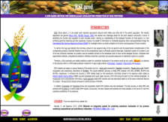
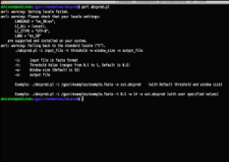


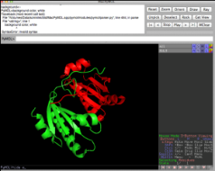
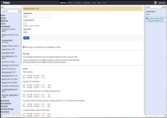
Introduction
Softwares
OSDD-Linux integrates open source softwares, libraries , workflows and webservices for creating environment for drug discovery. First attempt made to customize linux to provide services to community of drug discovery. OSDD-Linux may bring down cost as well as increase speed of drug discovery.
GPSR packages , webservers, standalone, galaxy versions of tools developed in Dr.Rahghava’s lab along with third party softwares like rasmol, pymol are integrated
Webservers
Standalone
A separate apache runs all web-servers as local host in the OSDD-Linux CD.
Command line tools have been integrated for analysing large scale data.
Features
A single platform for bioinformatics and cheminformatics.
Features
User can customize according to need.
Easy to install and free of cost.
It can be launched using LiveCD, Liive server, USB and virttualldesktop like virtualbox.
Provides source codes for various tools.
OSDDLinux : A Platform for Open Source Drug Discovery
OSDDLinux
Tools available in three formats e.g. webservers, standalone and galaxy.
Third party softwares
Galaxy
Open source softwares used in bioinformatics and cheminformatics have been integrated.
All softwares are integrated in galaxy servers for making the workflows.
System Requirements
Future directions
The user may use OSDDLinux from portable devices like CD/DVD, USB drive etc or install on local machine or virtual machine depending upon requirement.
More webservices, modules, debian packages will be updated on regular basis.

Slide 22
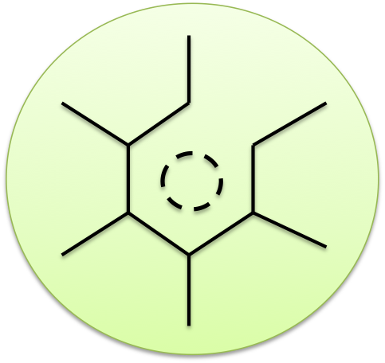

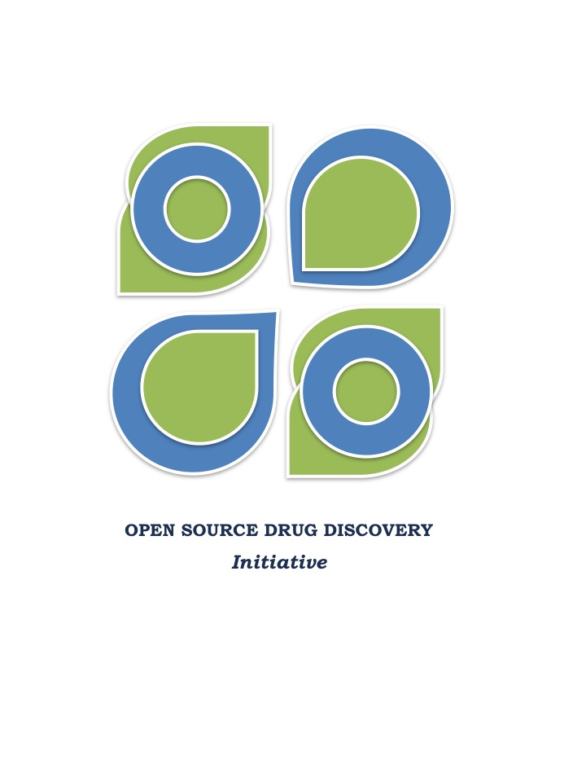
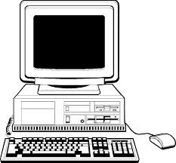
Drug Discovery manual
Installation Guide
Upgrade/New Packages
GPSR manual
Full Installation
On existing machine
Live DVD/USB
Virtual Box
Required Package
Users Guide
Package Repository
License
Platform for Developers
Linux for Students
Infrastructure for Developing World
Open Source Drug
Discovery (OSDD), a
mission to provide
affordable drugs for
poors, is in the process
of creating an in silico
platform for designing,
discovering and simulating
drugs. OSDD have initiate
number of projects to
Support In silico drug
discovery, including
OSDDlinux and computational
resources for drug discovery
(CRDD). OSDDlinux is a customized
linux operating system for drug
discovery that integrates
open source software, libraries,
workflows and web services in linux
for creating environment for drug discovery. First time an attempt has been made to customize linux to provide service to community working in the field of drug discovery. OSDDlinux may bring down the cost of drug discovery as well as it may increase speed of drug discovery. This open source operating system will allow students, academicians & researchers to contribute towards drug discovery/design.
Promoting Crowdsourcing in
Drug development
Network-Based Coloration
Bioinformatics
GPSR Basic Scripts
Education & Research
Vaccine Informatics
Analysis of NGS data
Drug Informatics
Bio therapeutics

Slide 23
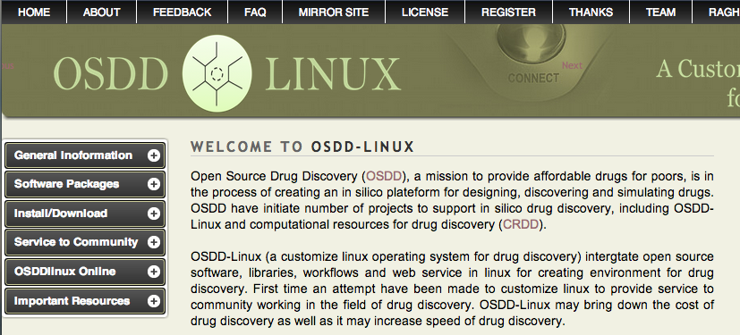

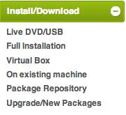
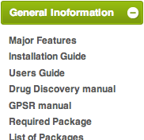
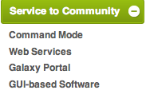
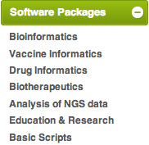
http://osddlinux.osdd.net/

