Slide 1

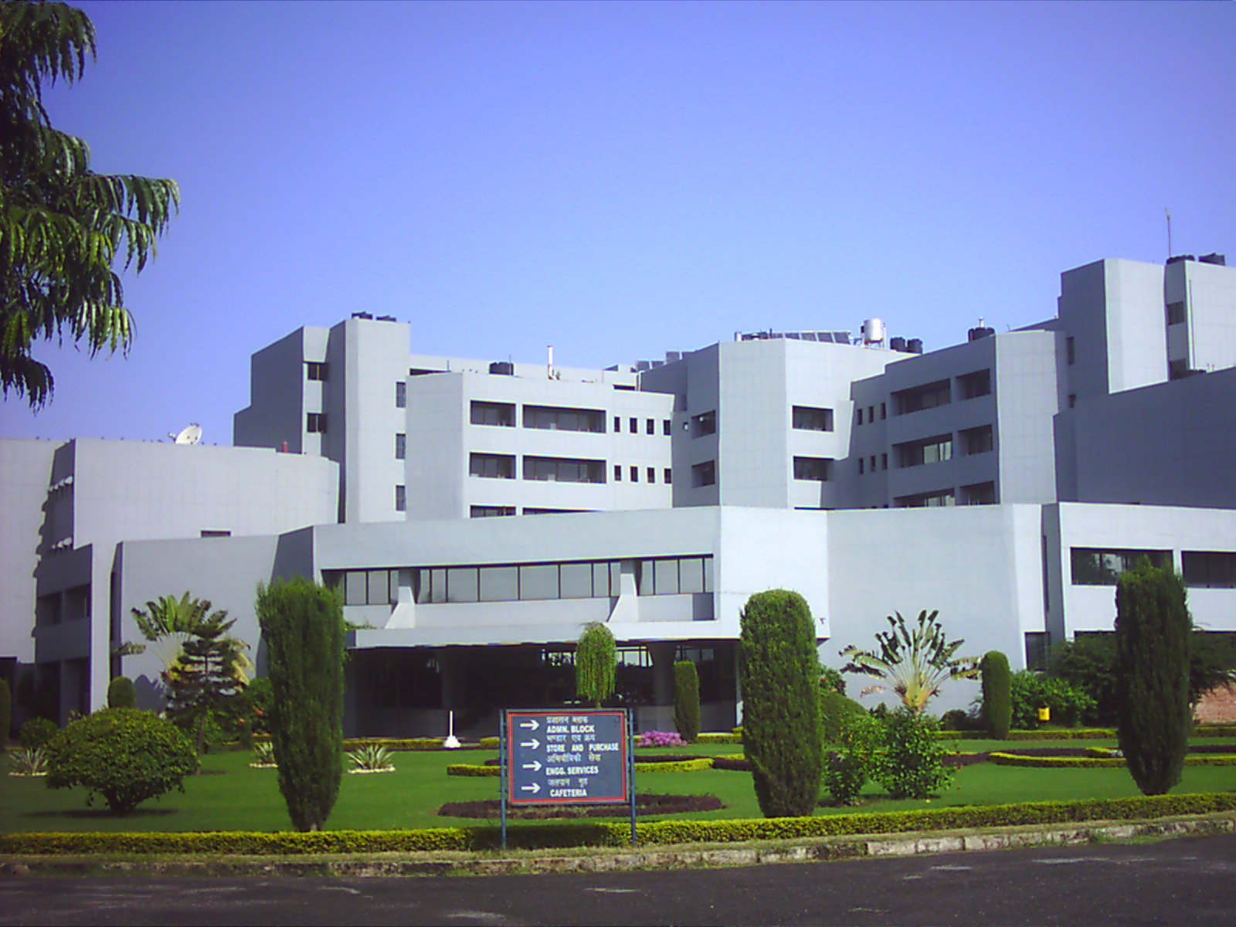
OSDDlinux: Operating System for Drug Discovery
Dr G P S Raghava, Head Bioinformatics Centre
Institute of Microbial Technology, Chandigarh, India
Bioinformatics Drug Informatics Vaccine Informatics Chemoinformatics
Email: raghava@imtech.res.in http://osddlinux.osdd.net/
http://ww.imtech.res.in/raghava/

Slide 2



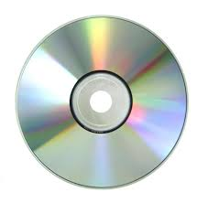
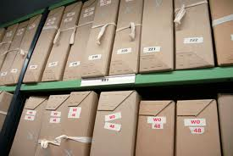




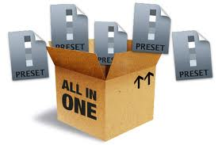
OSDDLINUX
Customized operating environment for drug discovery pipeline
Bioinformatics
Live Server
VACCINE Informatics
Live CD
ChemInformatics
Pkg Repository
Installation
Webserver
Standalone
Galaxy platform
All in ONE

Slide 3
My 25 Years in Bioinformatics
IMTECH is one of original DIC’s started by DBT
I start my carrier in 1986 as computer scientist
1986-91: Infrastructure (Email, NICNET, Medline)
1991-96: Services with computer programs
1996-2001: Protein structure, alignment web servers
2001-2006: Drug and Vaccine Informatics
2006-2011: Integration of tools & collaboration
2011-2016 ?: Drug/Vaccine in real life?

Slide 4
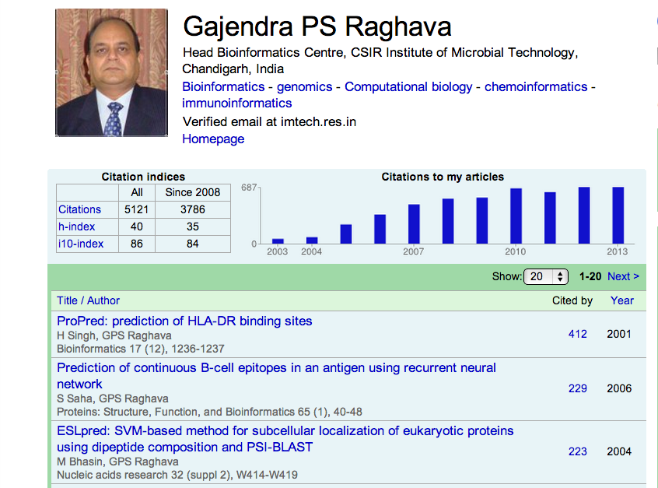

Slide 5
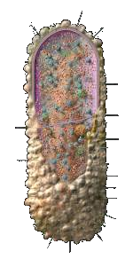
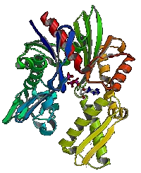
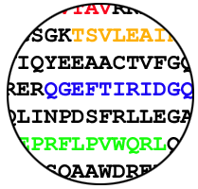
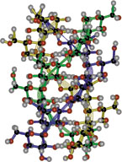
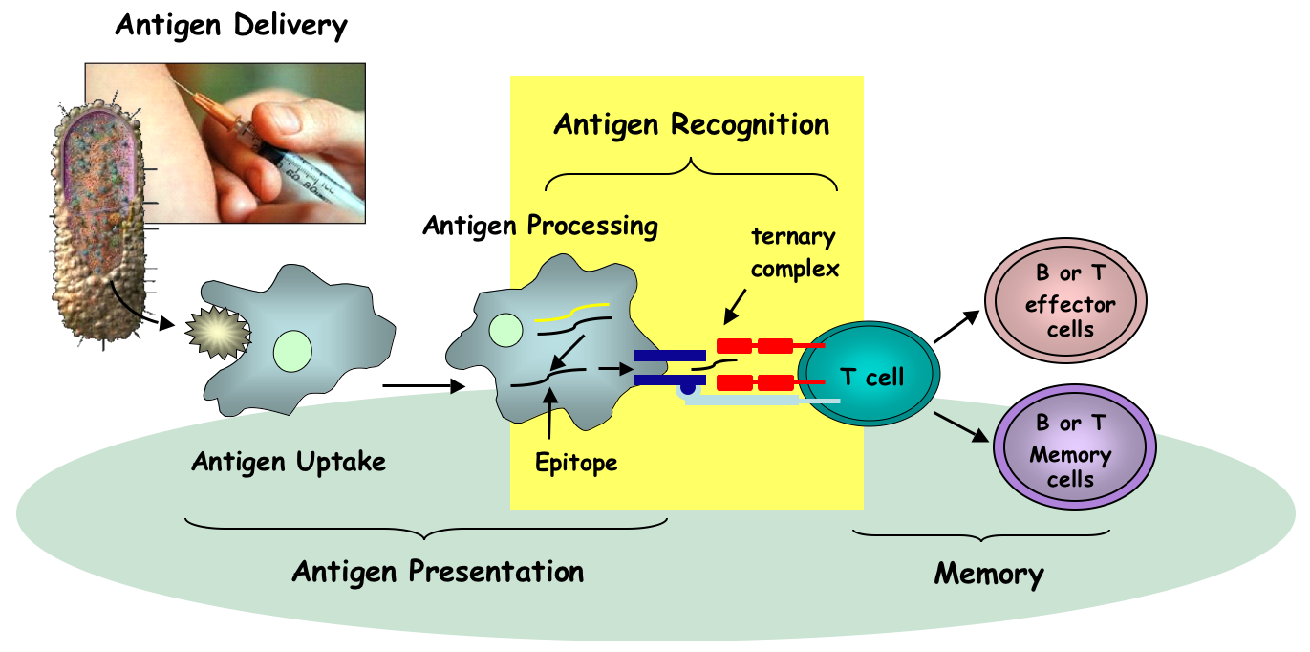
Adaptive Immunity
Protective Antigens
Vaccine Informatics
Bioinformatics Centre
Innate Immunity
IMTECH, Chandigarh
Vaccine Delivery
WHOLE
ORGANISM
Purified Antigen
Epitopes (Subunit Vaccine)
T cell epitope
Attenuated

Slide 6
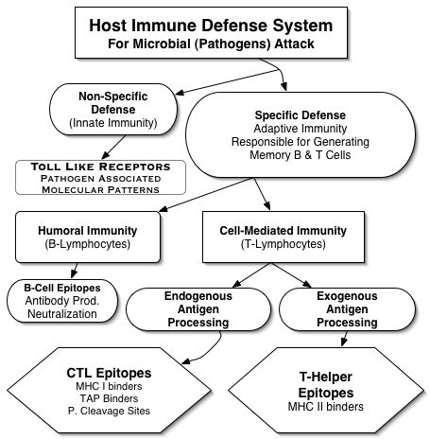
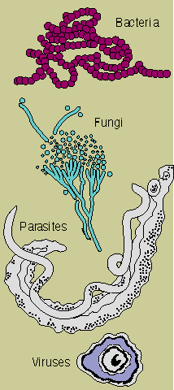
Immune Defense and Long Term Protection
Disease Causing Agents
Pathogens/Invaders

Slide 7
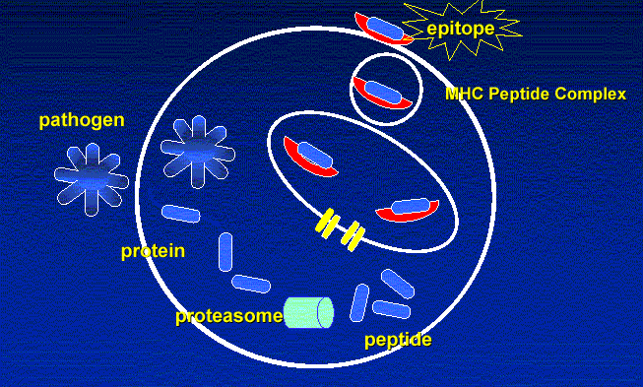

Adaptive Immunity
Vaccine Informatics
Protective Antigens
Innate Immunity
Bioinformatics Centre
IMTECH, Chandigarh
Vaccine Delivery
Endogenous Antigen Processing
ER
TAP
Prediction of CTL Epitopes (Cell-mediated immunity)

Slide 8
Prediction of B-Cell Epitopes
Adaptive Immunity
Vaccine Informatics
Protective Antigens
Innate Immunity
Bioinformatics Centre
IMTECH, Chandigarh
Vaccine Delivery
BCEpred: Prediction of Continuous B-cell epitopes
  Benchmarking of existing methods
  Poor performance slightly better than random
  Combine all properties and achieve accuracy around 58%
  Saha and Raghava (2004) ICARIS 197-204.
ABCpred: ANN based method for B-cell epitope prediction
  Extract all epitopes from BCIPEP (around 2400)
  700 non-redundant epitopes used for testing and training
  Recurrent neural network
  Accuracy 66% achieved
  Saha and Raghava (2006) Proteins,65:40-48
ALGpred: Mapping and Prediction of Allergenic Epitopes
  Allergenic proteins
  IgE epitope and mapping
  Saha and Raghava (2006) Nucleic Acids Research 34:W202-W209
CBTOPE: Prediction of conformational epitopes

Slide 9
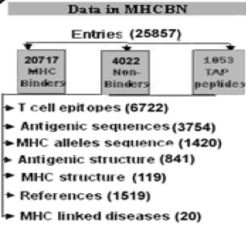
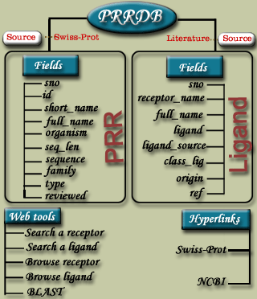
Modelling of Immune System for Designing Epitope-based Vaccines
Adaptive Immunity (Cellular Response) : T_{helper} Epitopes
Propred: for promiscuous MHC II binders
MMBpred:for high affinity mutated binders
MHC2pred: SVM based method
MHCBN: A database of MHC/TAP binders and non-binders
Pcleavage: for proteome cleavage sites
TAPpred: for predicting TAP binders
Propred1: for promiscuous MHC I binders
CTLpred: Prediction of CTL epitopes
Adaptive Immunity (Cellular Response) : CTL Epitopes
BCIpep: A database of B-cell eptioes;
ABCpred: for predicting B-cell epitopes
ALGpred: for allergens and IgE eptopes
HaptenDB: A datbase of haptens
Adaptive Immunity (Humoral Response) :B-cell Epitopes
Innate Immunity : Pathogen Recognizing Receptors and ligands
PRRDB: A database of PRRs & ligands
Antibp: for anti-bacterial peptides
Signal transduction in Immune System
Cytopred: for classification of Cytokines

Slide 10
Drug/inhibitor/vaccine/ Disease Diagnostics
Peptide-Protein Interaction
Peptide Structure, docked structure
Adaptive Immunity: B-cell, T-cell Epitope
Innate Immunity: Toll-like receptors
Anti-(bacterial , microbial, cancer, viral) peptides
Mimotopes for diseases diagnostics
Structure determination: Natural, non-natural , modified bonds
Peptide/ Proteins
Structure prediction: Natural, non-natural , modified bonds
Synthesis: Phase display, SPSS, Codon Suffeling
Natural bioactive peptides from metagenomics
Mimotopes for B/T epitopes
Mimicking of Drug Molecules
ADMET: Proteolytic enzymes, Half-life
Size Optimization for function/Str.
Oral Delivery : Trans. & Adjuvant

Slide 11
Important Resources/Databases
MHCBN: MHC binding and non-binding peptides
CPPsite: Cell penetrating peptides
BCIpep: B-cell epitope datbase
HMRbase: A database of hormones and their receptors
TumorHope: Tumor hoping peptides
TumorHPD: Designing of Tumor Homing Peptides
CellPPD: Designing of cell penetrating peptides
Pepstr: Prediction of Peptide structure
AntiCP: Prediction and designing of anticancer peptides

Slide 12
Designing of therapeutic peptides against cancer
Anticancer peptides Designing of effective anticancer peptides
Peptide inhibitors Identification of inhibitors against cancer targets
Cell Penetrating Peptides
CPPsite: Database
CellPred: Design
?
Tumor Homing Peptides TumorHoPe: Database TumorHPD: Design
Peptides Half-life
HLP: prediction in intestine
Depend on environment
Toxicity of Peptides
Immuno-, cyto-toxicity
Off targets

Slide 13
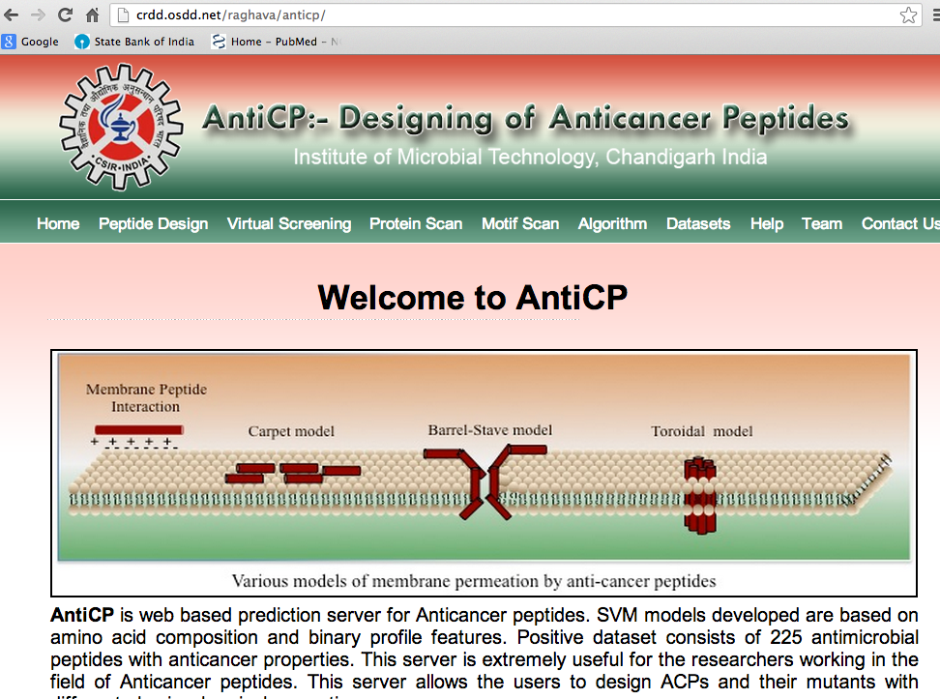

Slide 14
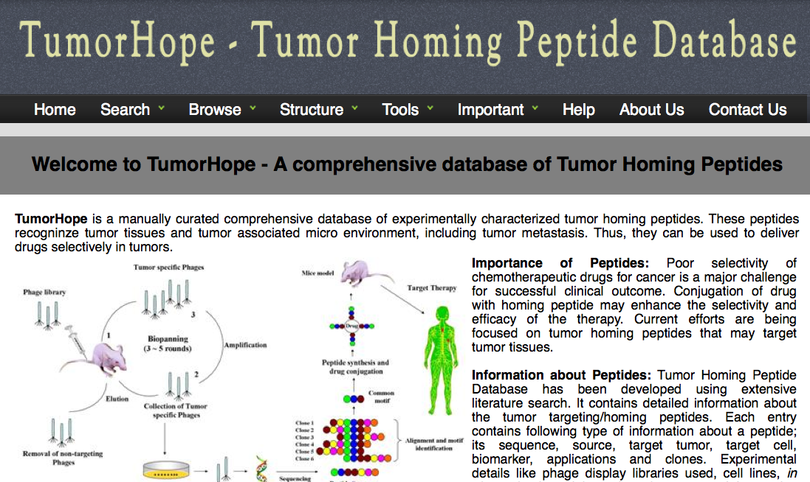
Peptide Resources/Databases
Work in Progress
1. Prediction of CPP 2. Designing CPP 3. Scanning in proteins

Slide 15
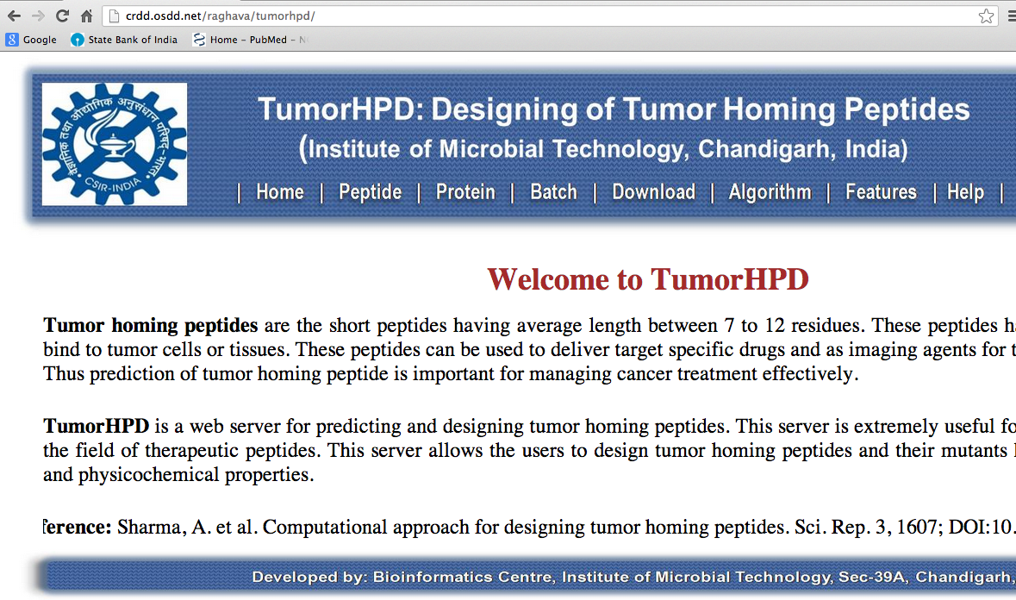

Slide 16
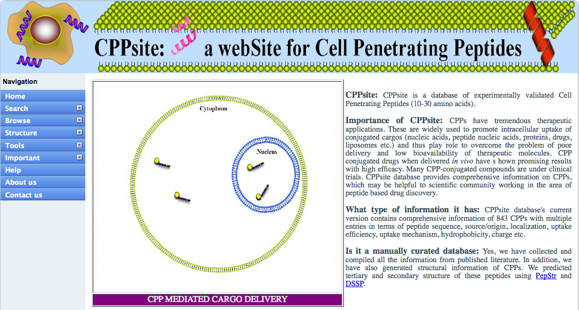
Peptide Resources/Databases
Work in Progress
1. Prediction of CPP 2. Designing CPP 3. Scanning in proteins

Slide 17
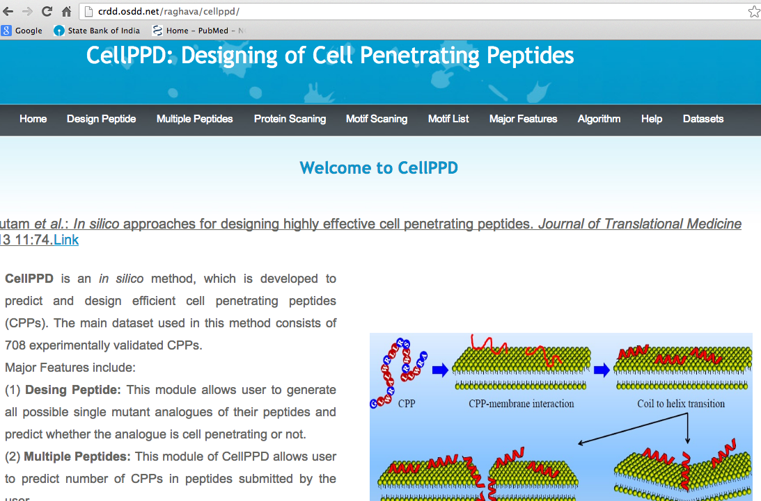

Slide 18
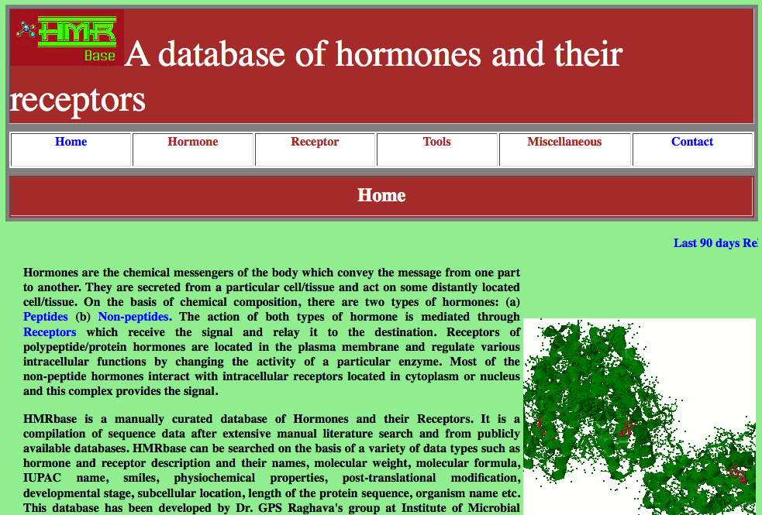
Peptide Resources/Databases

Slide 19
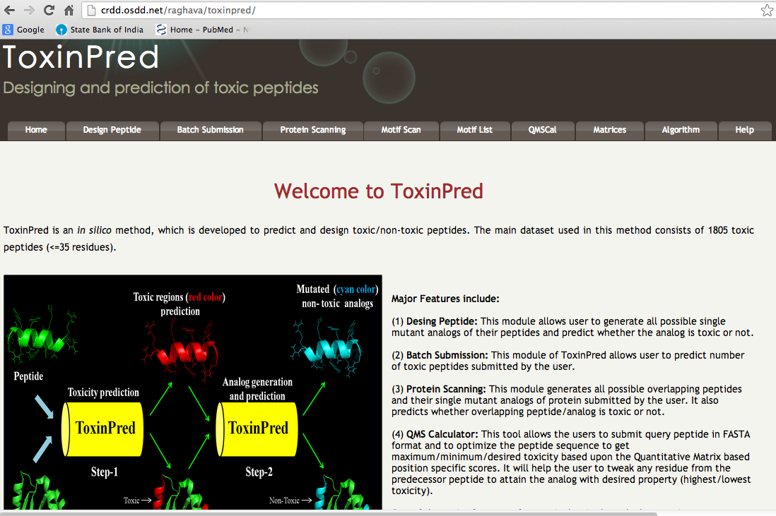

Slide 20
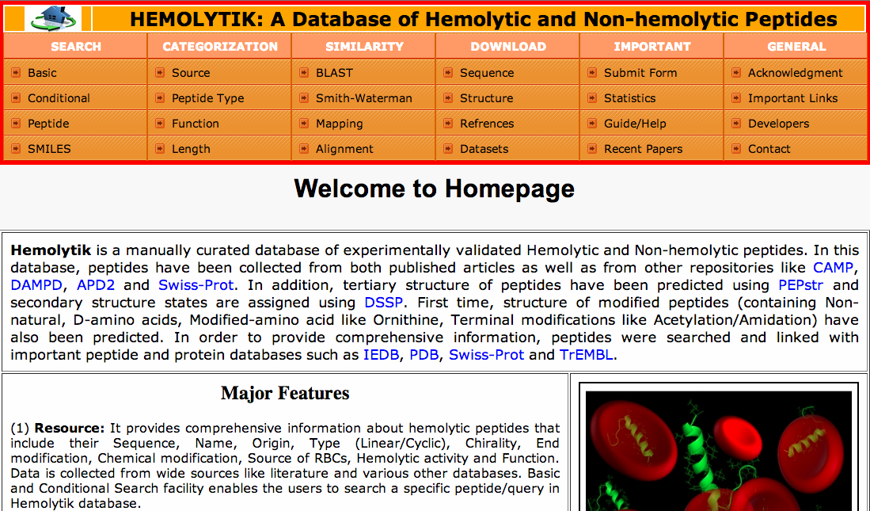

Slide 21
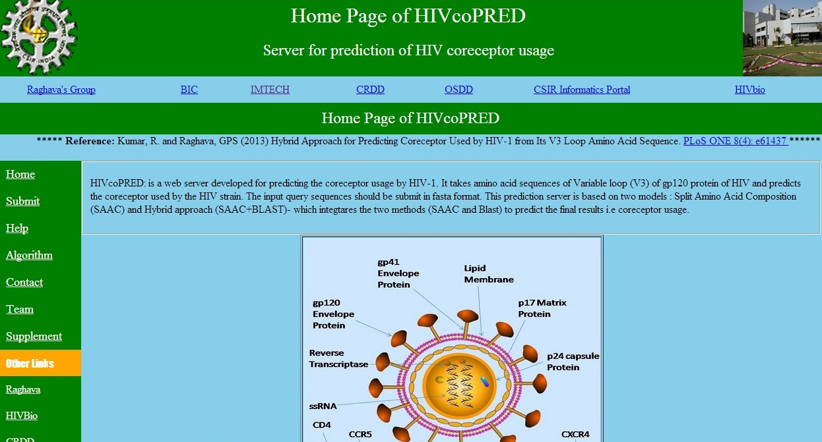
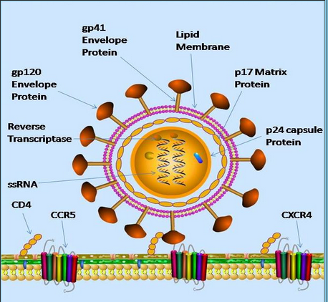

Slide 22
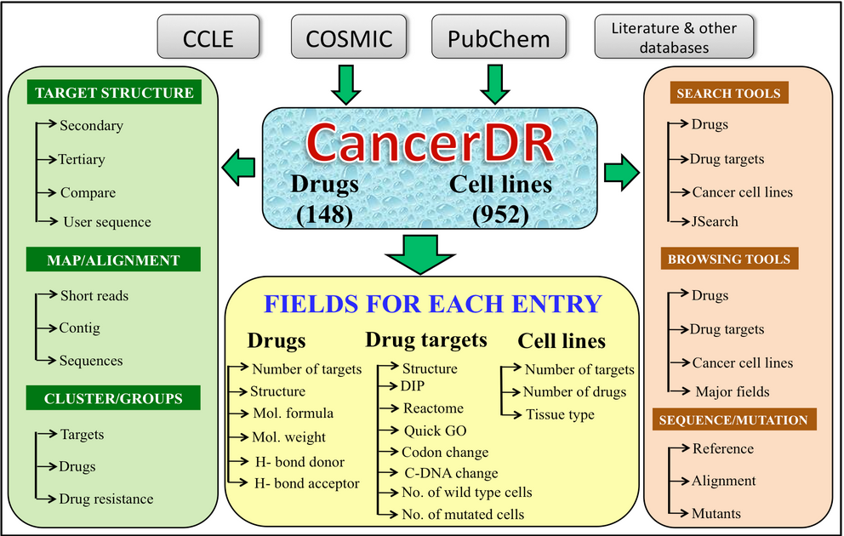

Slide 23
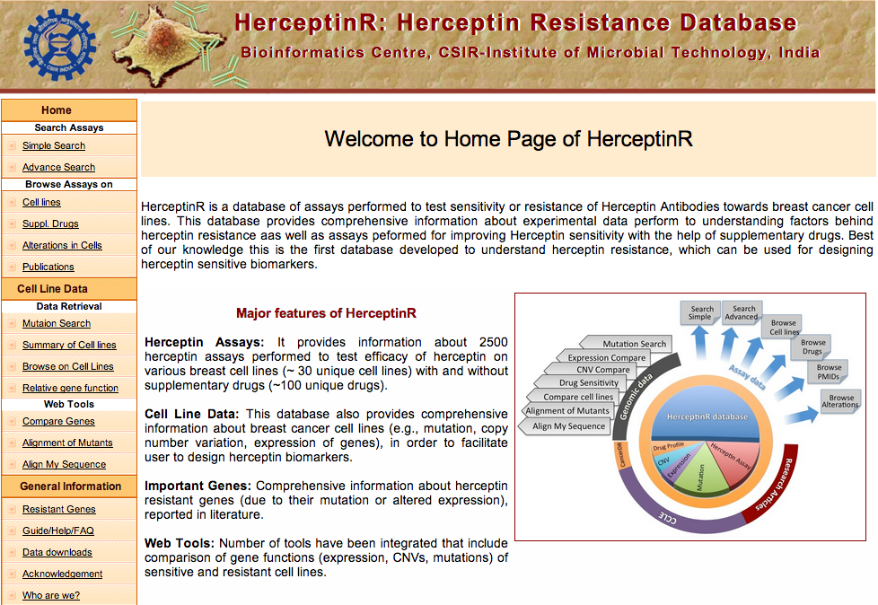

Slide 24
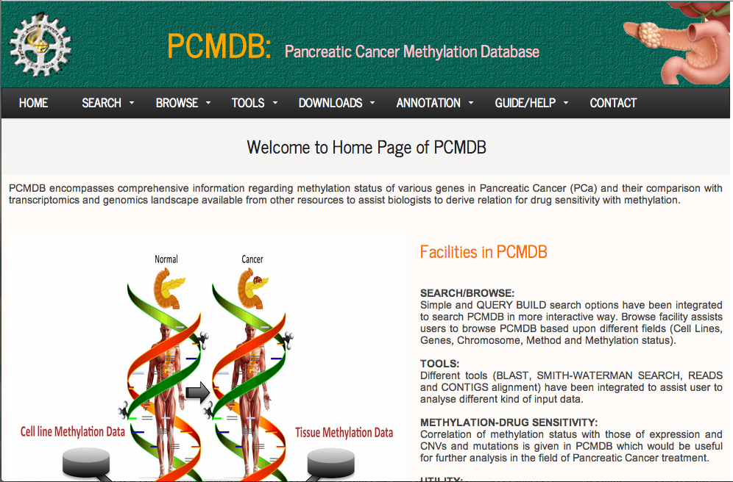
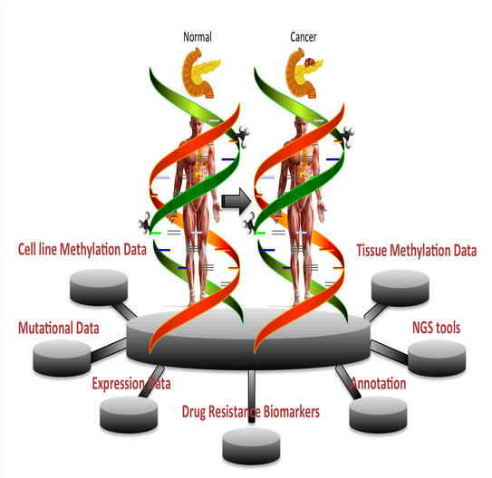

Slide 25
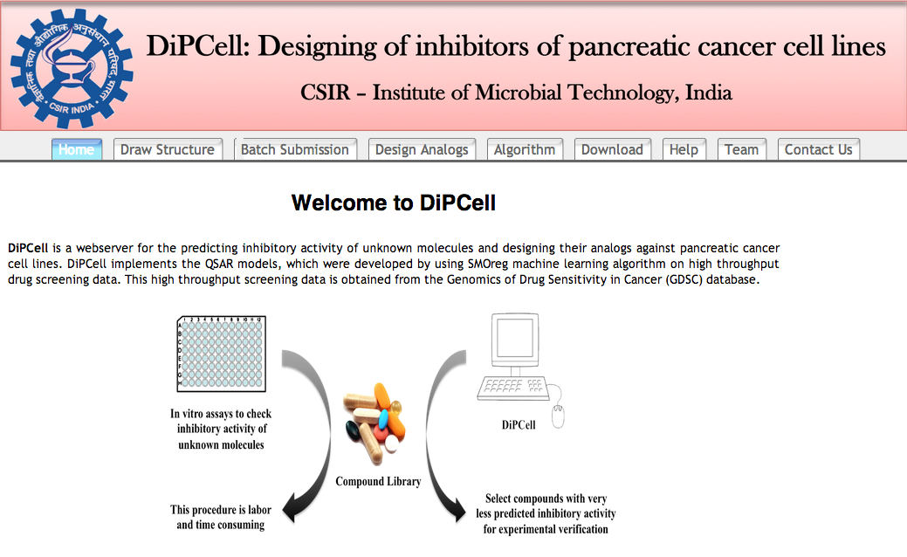

Slide 26
Genome assembly and annotation done at IMTECH
Burkholderia sp. SJ98 (Kumar et al. 2012).
Debaryomyces hansenii MTCC 234 (Kumar et al. 2012).
Imtechella halotolerans K1^{T} (Kumar et al. 2012).
Marinilabilia salmonicolor JCM 21150^{T} (Kumar et al. 2012).
Rhodococcus imtechensis sp. RKJ300 (Vikram et al. 2012).
Rhodosporidium toruloides MTCC 457 (Kumar et al. 2012).

Slide 27
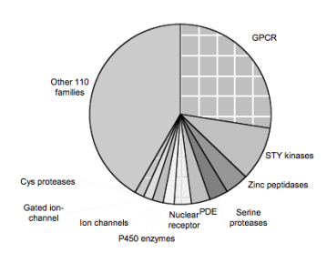
Computer-Aided Drug Discovery
Searching Drug Targets: Bioinformatics
Genome Annotation
FTGpred: Prediction of Prokaryotic genes
EGpred: Prediction of eukaryotic genes
GeneBench: Benchmarking of gene finders
SRF: Spectral Repeat finder
Comparative genomics
GWFASTA: Genome-Wide FASTA Search
GWBLAST: Genome wide BLAST search
COPID: Composition based similarity search
LGEpred: Gene from protein sequence
Subcellular Localization Methods
PSLpred: localization of prokaryotic proteins
ESLpred: localization of Eukaryotic proteins
HSLpred: localization of Human proteins
MITpred: Prediction of Mitochndrial proteins
TBpred: Localization of mycobacterial proteins
Prediction of drugable proteins
Nrpred: Classification of nuclear receptors
GPCRpred: Prediction of G-protein-coupled receptors
GPCRsclass: Amine type of GPCR
VGIchan: Voltage gated ion channel
Pprint: RNA interacting residues in proteins
GSTpred: Glutathione S-transferases proteins
Protein Structure Prediction
APSSP2: protein secondary structure prediction
Betatpred: Consensus method for β-turns prediction
Bteval: Benchmarking of β-turns prediction
BetaTurns: Prediction of -turn types in proteins
Turn Predictions: Prediction of α/ β/γ -turns in proteins
GammaPred: Prediction of-turns in proteins
BhairPred: Prediction of Beta Hairpins
TBBpred: Prediction of trans membrane beta barrel proteins
SARpred: Prediction of surface accessibility (real accessibility)
PepStr: Prediction of tertiary structure of Bioactive peptides

Slide 28
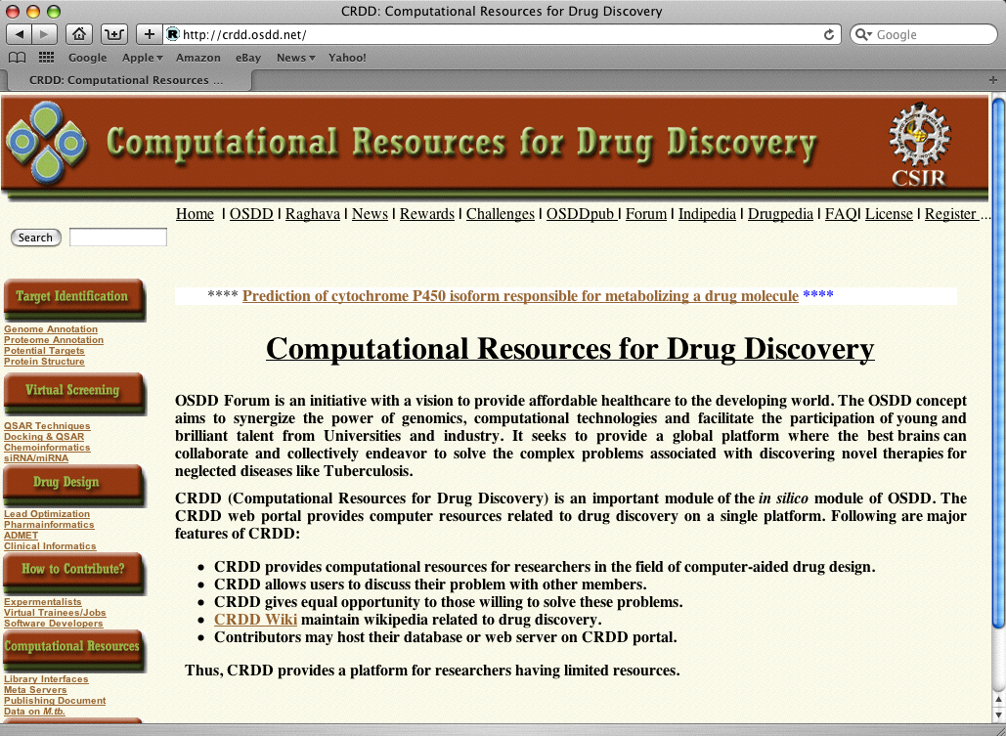

Slide 29
Limitations of existing web services
Uploading or downloading large data
Serving too many user from single source
Difficult to provide computer intensive job
Depend on internet and its bandwidth
Security of data in transition
Maintain confidentiality of data
Difficult to analyze graphical data

Slide 30
GPSR: A Resource for Genomics Proteomics and Systems Biology
A journey from simple computer programs to drug/vaccine informatics
Limitations of existing web services
  History repeats (Web to Standalone)
  Graphics vs command mode
General purpose programs
  Small programs as building unit
Integration of methods in GPSR

Slide 31
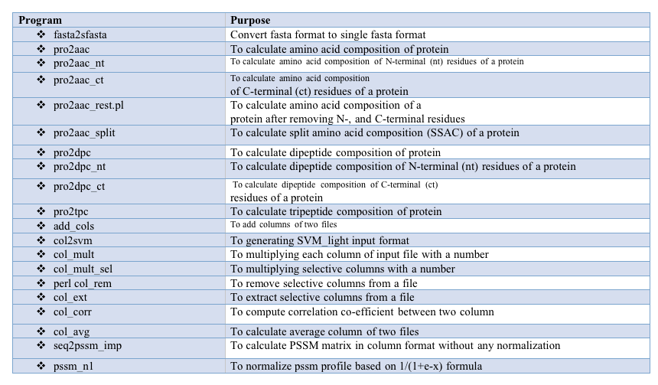
Thankyou

Slide 32
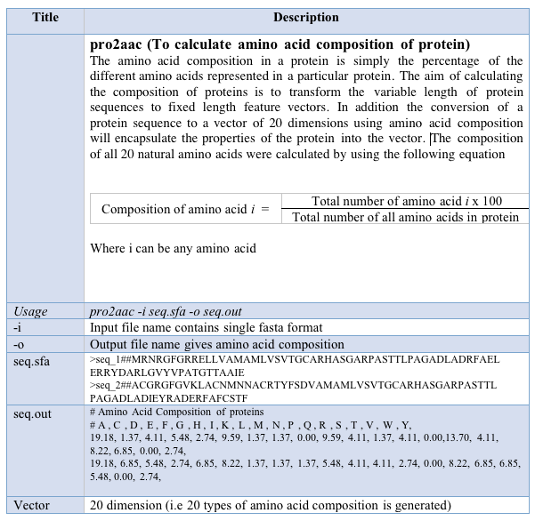
Thankyou

Slide 33
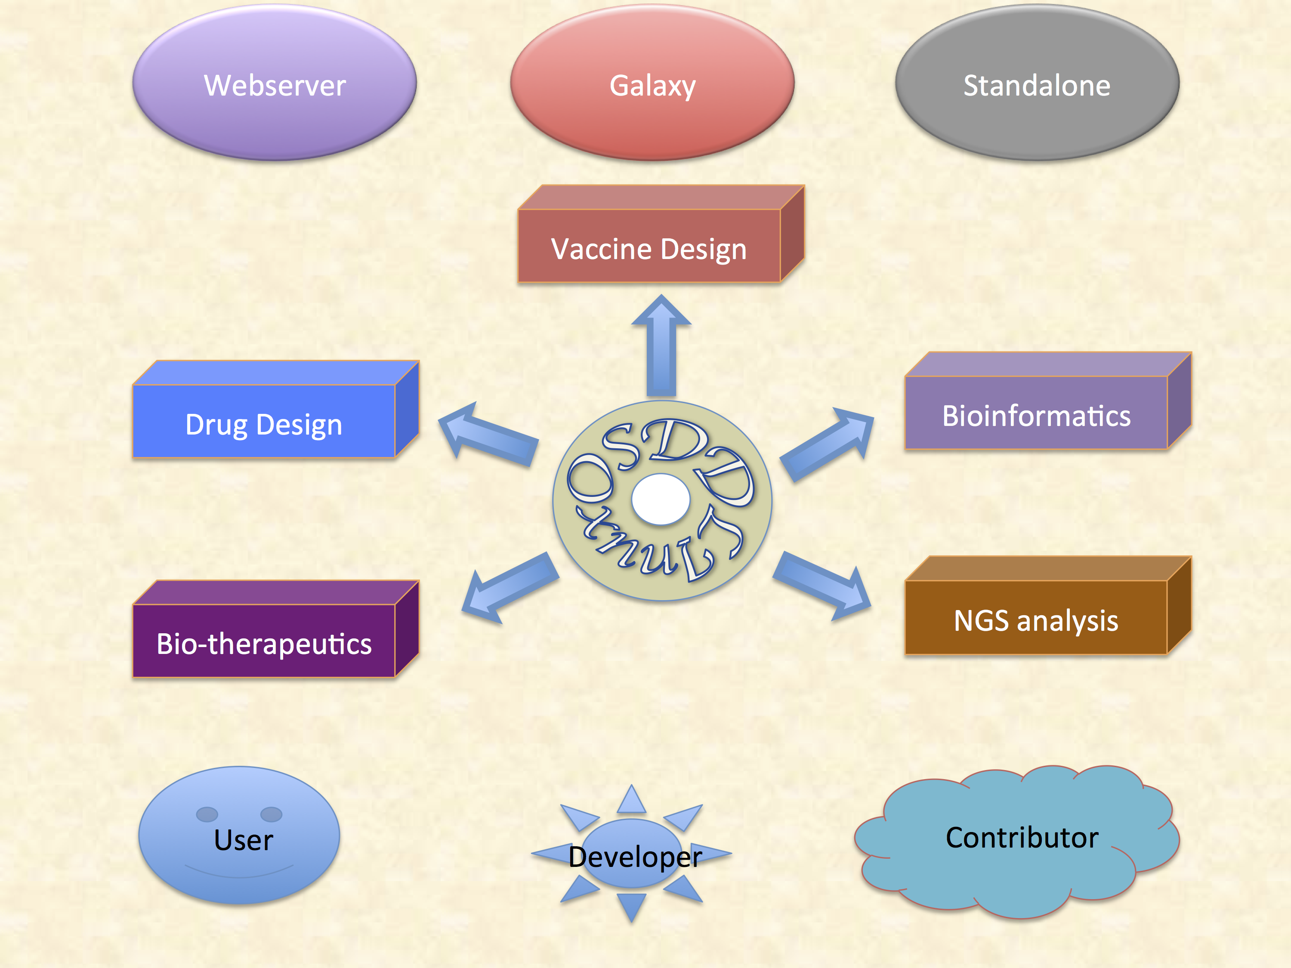

Slide 34
Major Features of OSDDlinux
Service for Scientific Community
Online for Occasional Users
LiveDVD/USB on local computer with Data Security
Platform for Developers
Developers with no infrastructure
Infrastructure on existing linux setup
Linux for Students
Bootable LivedDVD for occasional learning
OSDDlinux on Windows/MAC Users
Online hand-on experience on Linux & PERL programming

Slide 35
Major Features of OSDDlinux
Infrastructure for Developing World
Infrastructure for Bioinformatics
Assembling & Annotation of Genomes
Computer-aided drug design
Platform for launching services
Promoting Crowdsourcing
Example-based learning of Web servers
Galaxy-based platform for sharing
Network-Based Collobration

Slide 36
Installation of OSDDlinux
LiveDVD/USB
Download ISO image from web site
Create bootable DVD/USB from ISO image or send request
Boot your system from bootable DVD/USB
Select Install option for setting OSDDlinux on your system
Install on Existing System
Download base system set account and permission
Copy models, blastadata, webserver, galaxy from site
Set Vmbox on existing machine and install OSDDlinux
Download Options
Web-based download from web sites
RSYNC for sync your data

Slide 37
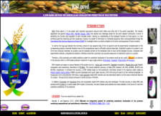
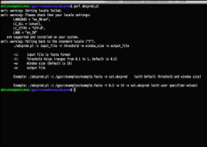


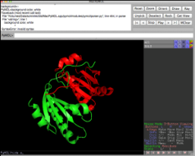
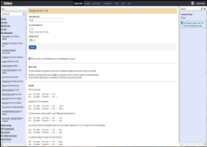
Introduction
Softwares
OSDD-Linux integrates open source softwares, libraries , workflows and webservices for creating environment for drug discovery. First attempt made to customize linux to provide services to community of drug discovery. OSDD-Linux may bring down cost as well as increase speed of drug discovery.
GPSR packages , webservers, standalone, galaxy versions of tools developed in Dr.Rahghava’s lab along with third party softwares like rasmol, pymol are integrated
Webservers
Standalone
A separate apache runs all web-servers as local host in the OSDD-Linux CD.
Command line tools have been integrated for analysing large scale data.
Features
A single platform for bioinformatics and cheminformatics.
Features
User can customize according to need.
Easy to install and free of cost.
It can be launched using LiveCD, Liive server, USB and virttualldesktop like virtualbox.
Provides source codes for various tools.
OSDDLinux : A Platform for Open Source Drug Discovery
OSDDLinux
Tools available in three formats e.g. webservers, standalone and galaxy.
Third party softwares
Galaxy
Open source softwares used in bioinformatics and cheminformatics have been integrated.
All softwares are integrated in galaxy servers for making the workflows.
System Requirements
Future directions
The user may use OSDDLinux from portable devices like CD/DVD, USB drive etc or install on local machine or virtual machine depending upon requirement.
More webservices, modules, debian packages will be updated on regular basis.

Slide 38
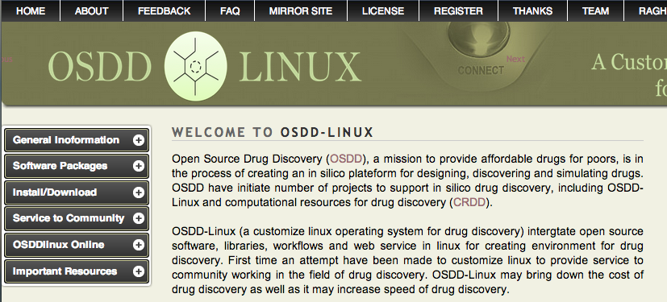

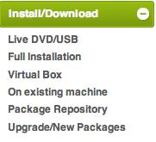
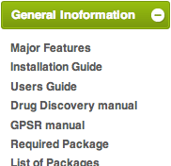
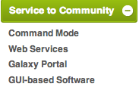
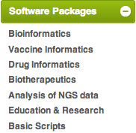
http://osddlinux.osdd.net/

